Slide 1
Emerging Legal Issues in Recent Transatlantic Science Fiction
The Inevitable Failure of Future Law?
David Murakami Wood
Canada Research Chair in Surveillance Studies
Queen’s University, Canada
dmw@queensu.ca

Slide 2
Outline
Methods
Headline Findings
Law: everywhere and nowhere in SF
Emerging Legal Issues in 3 science fictional worlds:
Charles Stross: Halting State (2007) / Rule 34 (2011)
Ken McLeod: Intrusion (2013)
Paulo Bacigalupi: The Water Knife (2015)
What does SF tell us about law?

Slide 3
Methods 1
Systematic survey element: sample = all major British and American SF prizes 2003-2012 (for books published 2002-2011)
Hugos, Nebulas, JWCM, BSFA, ACC, PKD, Locus, Tiptrees…
Collated nominees + winners: over 300 novels!
Tried various ways of shortening this mega-list:
Winners
Multiple-nominees
Combinations…
However now also extending it to 2013/14/15…

Slide 4
Methods 2
Long-list: either won and/or multiply-nominated: 87 novels (+)
Forms main pool for analysis of themes
Gradually reading all of these
Almost complete (never complete!)
Then: selected various novels that were either representative of a particular theme
Security
Surveillance…
Today: concentrating on novels that deal with crime and law

Slide 5
Shared Themes
War and insecurity everywhere
Bio/Genetic/Environmental SF (e.g. Gwyneth Jones (2004) Life; Paolo Bacigalupi (2009) The Wind-Up Girl)
Concern with Global South and the insecurity of Others (e.g. Geoff Ryman (2004) Air, everything by Ian McDonald, Lauren Beukes (2010) Zoo City)
Revival of alternative history (e.g. Connie Wills (2010) Blackout / All Clear)
Mainstreaming of slipstream / ‘new weird’ / urban fantasy (e.g. China Miéville (2009) The City & the City) and blurring of SF and fantasy
Turn to Self-referential fiction (e.g. Cherie Priest (2009) Boneshaker; John Scalzi’s (2012) Redshirts)
Nostalgia
Rise of Young Adult (YA) fiction

Slide 6
Emerging Legal Themes in Three Science Fictional Worlds

Slide 7
An observation
SF features a great deal of crime, policing, prisons, private eyes etc.
Other aspects of the judicial system, not so much – maybe not surprising
But consideration of ‘the law’ as a subject of SF is rare – and this is perhaps more surprising…

Slide 8
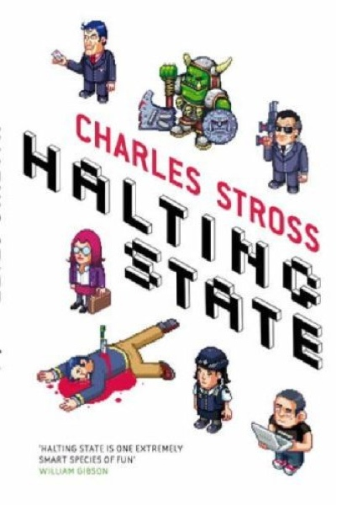

Slide 9
1. A finger in the dyke of techno-depravity
Charles Stross – dark and cynical humour: Situation Normal All Fucked Up…
Halting State (2007) / Rule 34 (2011):
‘Rebus’ in the near future
Crime in virtual worlds and the impracticality of geographical ‘jurisdiction’
Technological development and depravity: the (inevitable?) mismatch of human law and morality
But: justicia ex machina – AI will judge us – c.f. Kim Stanley Robinson’s Aurora (2015)

Slide 10
2. If you see something say something…
Increasing importance of quasi-crime and quasi-law
Guidelines, codes of practice, recommendations
Empowers vigilantism
Your traces will betray you: body or digital
Six degrees of separation becomes probable cause
Pre-crime: ‘politics of possibility’ (Amoore)
Always backed by (threat of) force
Surveillance technologies
‘Torture-lite’ and consensual interrogation

Slide 11
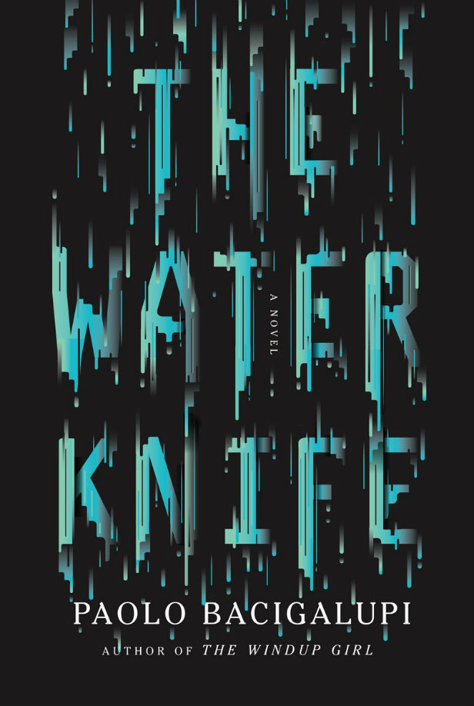
3. Environmental Lawfare
Law as justification for extreme measures in Paulo Bacigalupi’s The Water Knife (2015)
Lawyers entirely bound up in corporate resource wars
Statutes and contracts as ‘secret weapons’
Use of private contractors as enforcers
Court decisions as ex-post-facto justification for nefarious plans

Slide 12
What does SF tell us about law?
Law seems contingent and exceptionalism becomes normal
Law is differential in range and speed:
Law that defines security is fast paced and both specific and wide-ranging - its transformations are beyond ordinary people
Law that protects people (human rights etc.) is slow, over-general and has gaps
Law is a tool of powerful interests
Law is always backed by threat / use of violence
Technology will outpace law to the point where the veredictum of intelligent machines no longer needs the juris dictum of humanity…

