Slide 1
AdTech Gone Wrong: The Regulation of AdBlockers
Thomas Höppner, GikII, 25 September 2015, Berlin

Slide 2
What is AdTech?
short for Advertising Technology
Aim: Deliver better digital ads
= Ads with the right content for the right customer at the right time
Problem: Consumers are using adblocking solutions to prevent the display of digital advertisting

Slide 3
What is an AdBlocker?
A content-filtering extension for web browsers that stops unwanted adverts from appearing on websites the consumer visits
Most AdBlockers are free and can be downloaded easily
Providers monetize their software by offering website operators a place on the „whitelist“ for „acceptable adverts“ – sometimes based on a revenue share agreement

Slide 4
General business without AdBlockers
Advertiser
Publisher
AdBlocker
Consumer

Slide 5
How does a website look using an AdBlocker?

Slide 6
The blocking of Facebook Ads

Slide 7
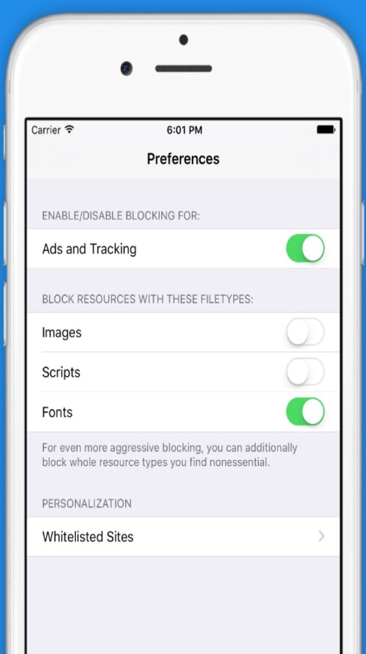
AdBlocker in IOS 9 - Apple enabled “content blocking” extension
With IOS 9 developers can create content filter extensions for the Safari browser
Users can easily install the extension and activate the blocking of ads or other content
Fact: 17.5 % of the users worldwide use Safari

Slide 8
The German Regional Court of Munich (Case No. 37 O 11673/14)
First cases in Germany
The Case:
The Parties: RTL, ProSiebenSat.1 Digital and Süddeutsche Zeitung vs. Eyeo GmbH – developer of AdBlock Plus
The Complaint: Plaintiffs claim that the opinion of paying to join a whitelist of “acceptable adverts” is an inadmissible business model
AdBlock Plus infringes the prohibition of a deliberate hindrance of a competitor pursuant to the German law of fair trading practices
Legal Basis: The German law on fair trading practices, copyright law and competition law
Photo by Eyeo GmbH; https://eyeo.com/press

Slide 9
The German Regional Court of Munich (Case No. 37 O 11673/14)
Holdings:
No competitive relationship between the parties
The aims differ fundamentally
Separate markets for adblockers and advertisers
No deliberate hindrance of the plaintiffs
There is still the possibility to appear on the whitelist
No general market disturbance
No infringement of copyright law
Contracts between the website operators and the defendant are not anti-competitive agreements
No market dominance of the defendant

Slide 10
District Court of Hamburg (Case No. 416 HKO 159/14)
The Case:
The Parties: Zeit Online and Handelsblatt vs. Eyeo GmbH
The Complaint: The plaintiffs bring an action for an injunction against Eyeo´s practices (with or without whitelisting), which willful interfere with their business.
Legal Basis: Competition & Copyright, German Unfair Competition Act
Holding of the Court:
Eyeo’s adblocking practice did not willfully interfere with Plaintiffs’ business
Eyeo’s business and Plaintiffs’ businesses were not close enough to create a competitor relationship
Users, not Eyeo, control what content they want to block (no willful interference.) Browsing a website while enabling adblocking is not an act that is relevant to copyright.

Slide 11
District Court of Cologne
The Case:
The Parties: Axel Springer vs. Eyeo GmbH
Date of Decision: Fall 2015 (Expected)
Legal Basis: Competition (§ 4 Nr. 10 UWG)
The Complaint: Similar to Hamburg/Munich. Whether selective whitelisting is anticompetitive through charging of different rates among publishers.
Holding of the Court: In its preliminary resolution, the court questioned the legality of whitelisting websites under the German Unfair Competition Act.

Slide 12
Concluding Remarks
Holdings of the courts:
ignored the profound contradiction of AdBlockers offering a „whitelist“
ignored the relevance of advertising for media pluarility and diversity
market definition is unparalleled
Publishers` possible actions:
publishers may invest in tools that evade AdBlocker
they make the adverts more „user friendly“
or they change to a subscription model
Controversy:
198 mio. global users of AdBlockers vs. more and more anti-AdBlocker developers

Slide 13
Thank you for your attention!
Dr Thomas Höppner Mobile: +0174 934 5022 thomas.hoppner@olswang.com
Berlin +49 30 700 171 100 Brussels +32 2 647 4772 London +44 20 7067 3000 Madrid +34 91 187 1920 | Munich +49 89 206 028 400 Singapore +65 6720 8278 Paris +33 17 091 8720 Thames Valley +44 20 7071 7300
Olswang: Changing Business.
www.olswang.com

