Slide 1
Smart Smart Contracts
Neural Networks on Ethereum’s Distributed Virtual Machine
AI on the blockchain
Tim Watts – Prot Technology
email: tim@we-are-prot.com | twitter: @readevalprint

Slide 2
Blockchain
email: tim@we-are-prot.com | twitter:@readevalprint

Slide 3
What is consensus?
We all agree on something
the Two Generals’ Problem
Paxos is a consensus protocol in an unreliable network
Raft is an alternative to Paxos
Bitcoin
email: tim@we-are-prot.com | twitter:@readevalprint

Slide 4
The Two Generals’ Problem
a thought experiment meant to illustrate the pitfalls and design challenges of attempting to coordinate an action by communicating over an unreliable link
wikipedia
email: tim@we-are-prot.com | twitter:@readevalprint

Slide 5
Solutions
Paxos
Super complex
Few implementations
Raft
Simple, tons of implementations
Trusted peers, Sybil Attack
email: tim@we-are-prot.com | twitter:@readevalprint

Slide 6
Enter the Blockchain
Bitcoin fights Sybil with Proof of Work. Yay!
But is wasteful :(
email: tim@we-are-prot.com | twitter:@readevalprint

Slide 7
Ethereum
running “contracts” on virtual machine
contract = code and state
self executing and inforcing
turing complete
email: tim@we-are-prot.com | twitter:@readevalprint

Slide 8
Two ways to interact with Ethereum
This is important, remember this!
Locally
Query values
run a program and examine its output
nothing saved
Globally
Save values to blockchain
Commit a transaction (run program)
global consensus
email: tim@we-are-prot.com | twitter:@readevalprint
Notes:
Talk about sending funds to contracts

Slide 9
Artificial Intelligence
(Almost)
email: tim@we-are-prot.com | twitter:@readevalprint

Slide 10
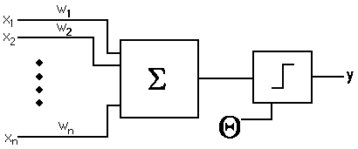
What is a perceptron?
The perceptron algorithm dates back to the late 1950s; its first implementation, in custom hardware, was one of the first artificial neural networks to be produced. (wikipedia)
email: tim@we-are-prot.com | twitter:@readevalprint

Slide 11
My project: BlockBrain
https://github.com/we-are-prot/blockbrain
Currently: Single neuron
Goal: Library of machine learning algorithms
next: demo
email: tim@we-are-prot.com | twitter:@readevalprint

Slide 12
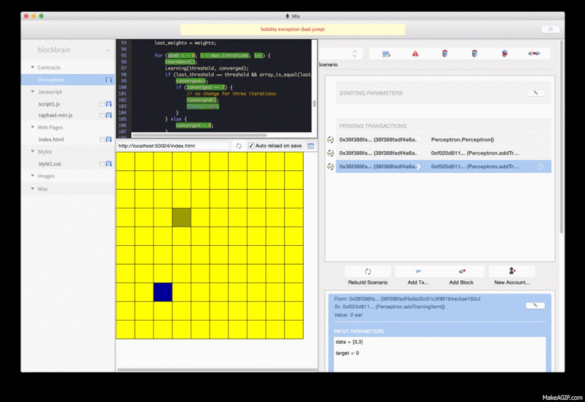

Slide 13
Tim that wasn’t artificial intelligence. Not even close.
email: tim@we-are-prot.com | twitter:@readevalprint

Slide 14
Who cares?
email: tim@we-are-prot.com | twitter:@readevalprint

Slide 15
Answer: You do.
Practical application
Neural nets can compute any function*
Universal Approximation Theorem
Community trained intelligence
Local usage maintains privacy
siri calls home, shame
*continuous
email: tim@we-are-prot.com | twitter:@readevalprint

Slide 16
Answer: Your kids do.
Can a deterministic system have self awareness?
If general artificial intelligence is developed and run on a censorship proof network
Who can stop it?
See also: AI in a box
email: tim@we-are-prot.com | twitter:@readevalprint

Slide 17
Bonus question
Remember before: Local interactions can be purely ephemeral. Global transactions are committed.
Equal to parallel dreams indistinguishable from reality but never remembered.
Would local instances have rights?
Is it ethical to run without committing results?
email: tim@we-are-prot.com | twitter:@readevalprint

Slide 18
Thank you
fin.
email: tim@we-are-prot.com | twitter:@readevalprint

