Slide 1
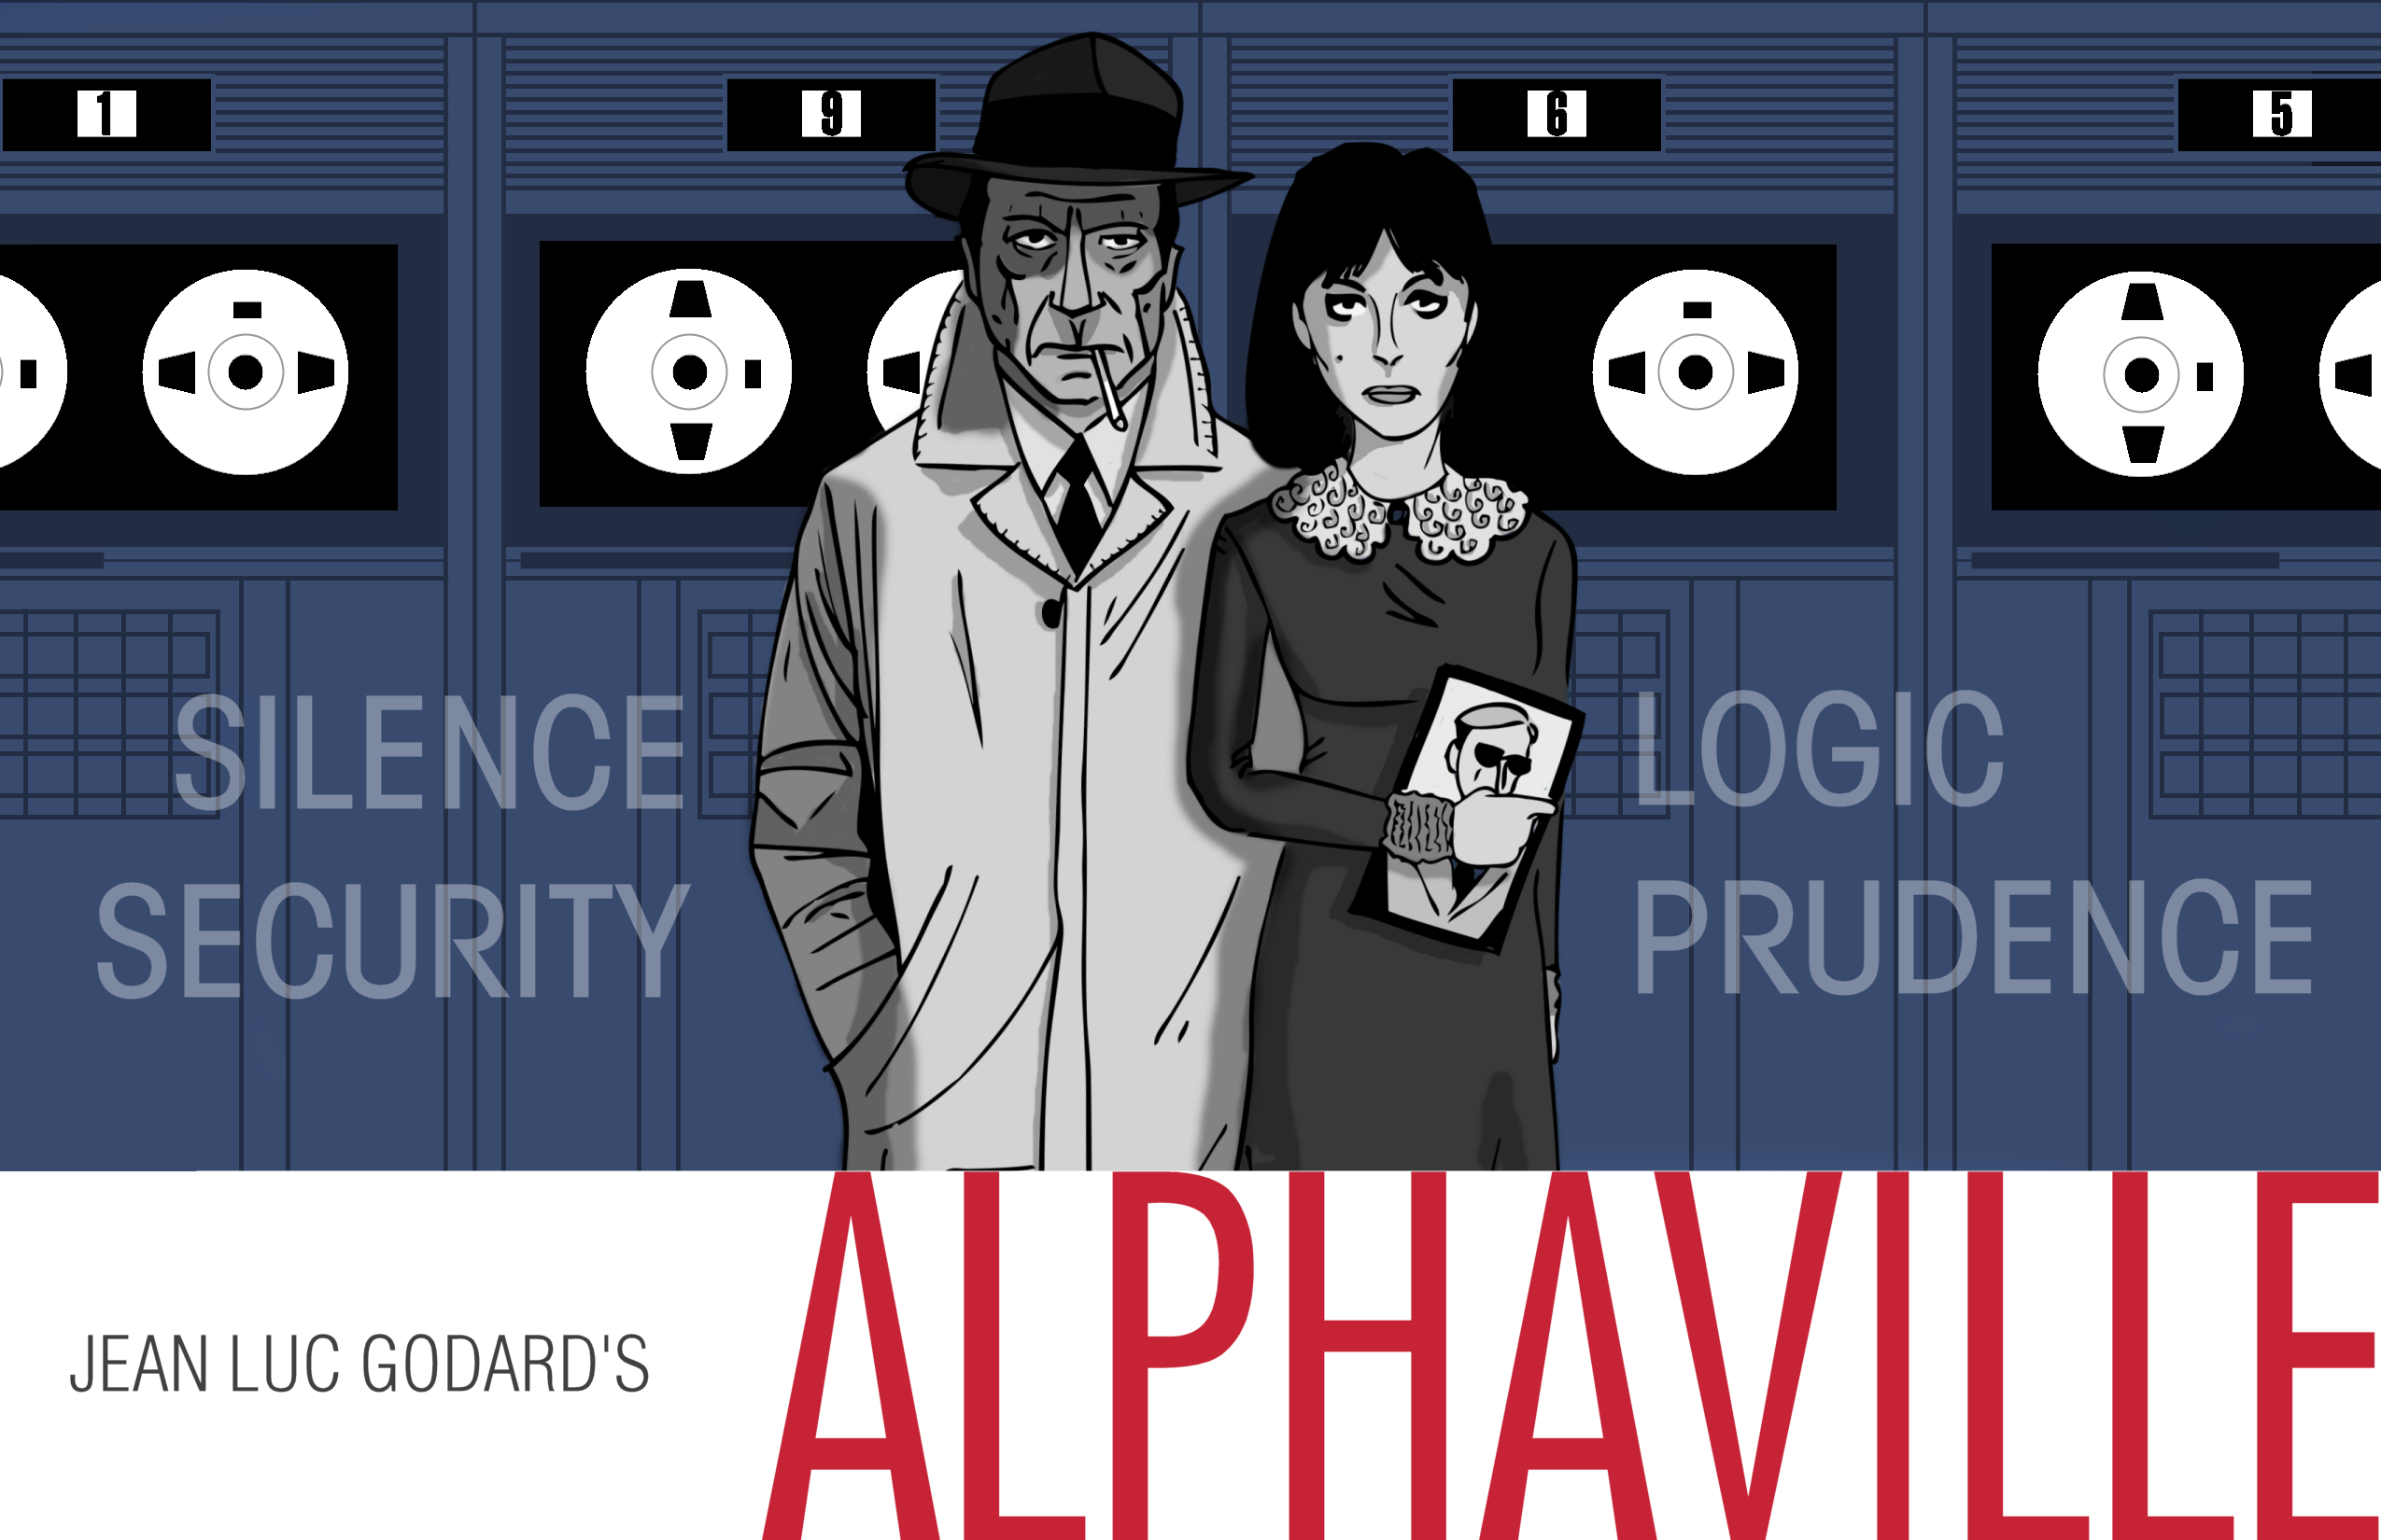
Blockchain
The Ethereum World Computer – Individual Empowerment or the first step to even more information control?

Slide 2
To research, design and build software that, as best as possible, facilitates, in a secure, decentralised and fair manner, the communication and automatically-enforced agreement between parties.
Notes:
mission statement

Slide 3
TOC
Intro
What is the (Ethereum) World Computer?
Blockchains / Bitcoin
Ethereum
The Legal Connection
Analysis – indivdual empowerment or control?
World Computers in SciFi
Conclusion

Slide 5
Intro
World-computers in (pop)culture
Often very negative
Ethereum has been alluded to as „Skynet“ (or Freenet)
Own descr.: „World Computer“
(or distributed calculator)
Towards empowerment or control?

Slide 6
What is Ethereum/“World Computer“?

Slide 7
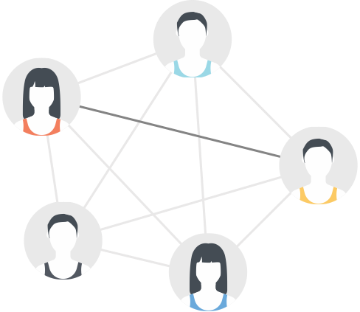
P2P file-sharing network
DECENTRALIZED SYSTEMS
NODE - PEER (A)
NODE - PEER(B)
Notes:
Decentralized networks are also known as peer-to-peer, or P2P.
The network is a connection of nodes known as peers.

Slide 8
OPEN-SOURCE TRUST
“If I have more than
$100, I agree to give
$10 to Tom.”
People can make agreements….
Notes:
People must be trusted to be true to their word. If they change their
mind or are untrustworthy, deviation from agreement is possible.

Slide 9
OPEN-SOURCE TRUST
“Actually, Tom doesn’t
really deserve this
money.”
…and not live up to them.
Notes:
Enforcement is often difficult, expensive, and ultimately not worth it.

Slide 10
OPEN-SOURCE TRUST
if wallet.balance > 100 then wallet.send(tom,10)
Software does what it is coded to do.
Notes:
Software does what you tell it to. Open Source software can
be reviewed by anyone to verify it will do what it says.

Slide 11
OPEN-SOURCE TRUST
if wallet.balance > 100 then wallet.send(tom,10)
Open Source software can be seen and audited by anyone.

Slide 12
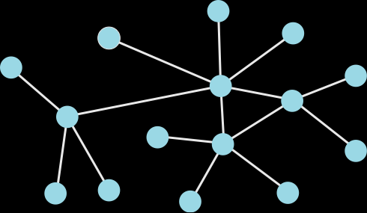
DECENTRALIZED
CENTRALIZED
Distribution of Power
Fault-tolerant/Resilient
Slower decision making
Faster decision making
Reduced Redundancy
Centralization of Power
Central point of failure
Notes:
Software does what you tell it to. Open Source software can
be reviewed by anyone to verify it will do what it says.

Slide 13
What is a Blockchain?

Slide 14
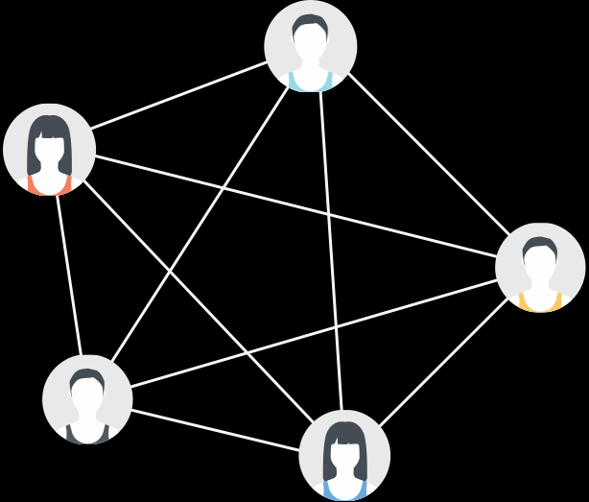
In cryptocurrency systems each account has a balance, but there is no physical token to hold.

Slide 15
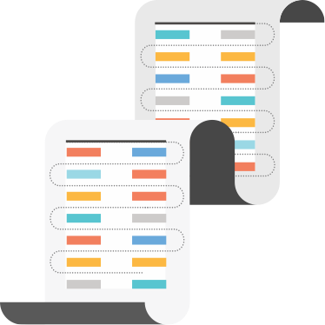
Blockchains serve as a foundation for decentralized agreement on what those balances are.

Slide 16
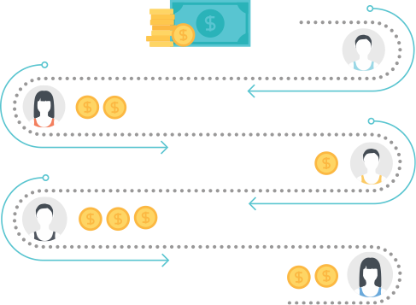
It is the shared, collective history of transactions on the network.

Slide 17
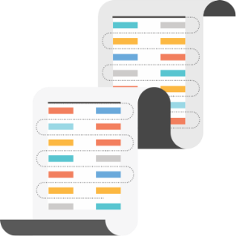
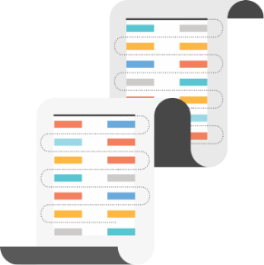
A copy of the blockchain is stored on each user’s computer.

Slide 18
The blockchain and its transactions are fully public and may be seen by anyone.

Slide 19
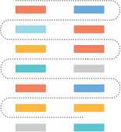
Block Approval

Slide 20
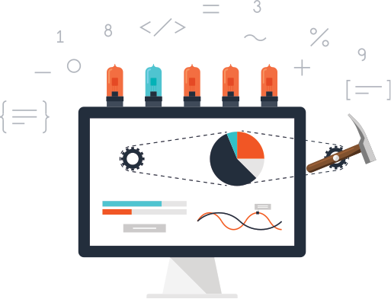
Mining

Slide 21
why use blockchains ?
… as a data layer
… as a protocol
… as a public ledger
… as a mechanism

Slide 22
Blockchains

Slide 23
What is Ethereum?

Slide 24
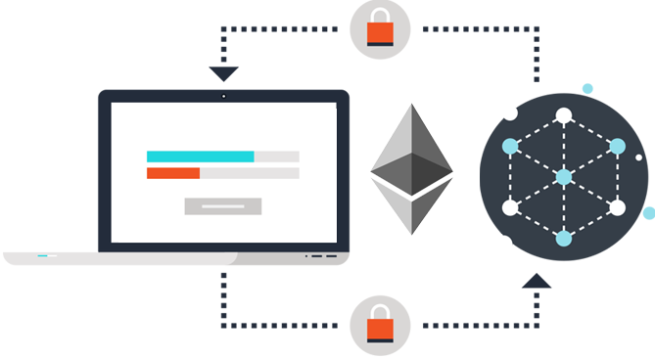
Ethereum is a platform that makes it possible for any developer to build and publish next-generation distributed applications.
WHAT IS ETHEREUM?

Slide 25
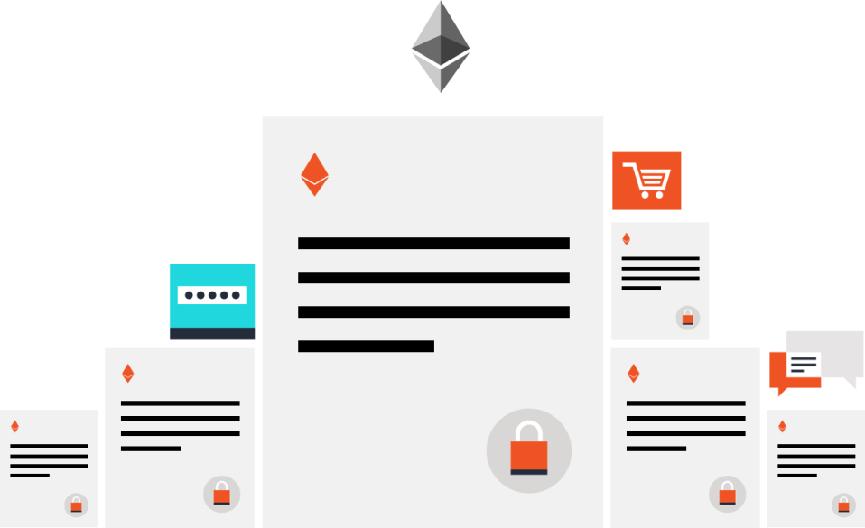
Code-based contracts are the main building blocks of Ethereum.
CONTRACT-BASED
Notes:
Ethereum’s primary programming language is a javascript-like language called Solidity. Complete list of languages: Solidity: Javascript-like language.
Serpent: Python-like language. Mutan: C-like language.
LLL: Lisp-like language. All other languages are implemented in LLL.

Slide 26
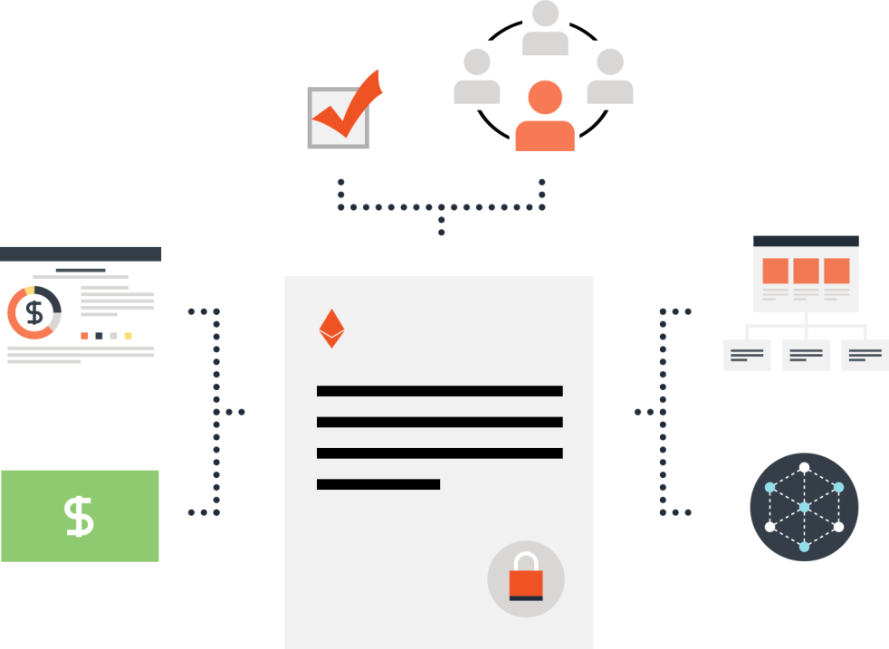
Contracts can be used to build currencies, financial derivatives, voting systems, decentralized organizations, data feeds, title registries and thousands of other applications.
ETHEREUM IS VERSATILE

Slide 27
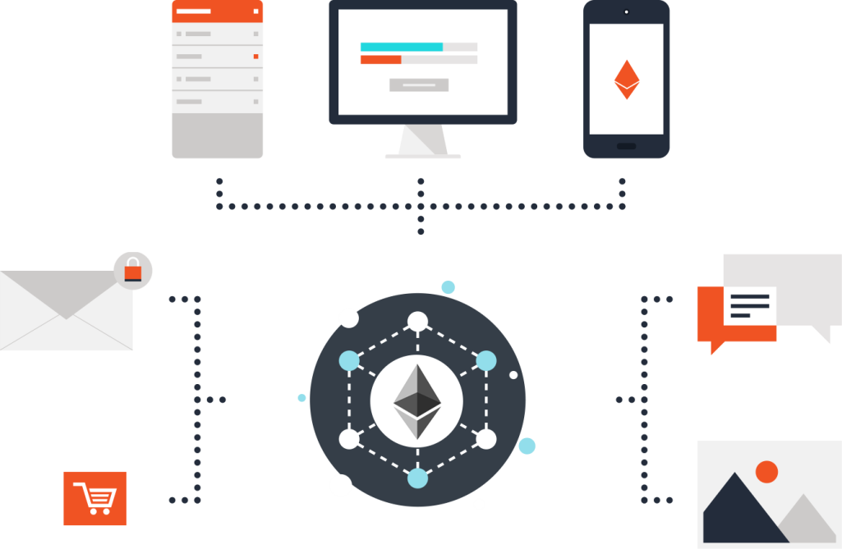
Ether is Ethereum's cryptofuel. It is a type of digital token that powers the applications on the decentralized network.
ETHER IS THE FUEL

Slide 28
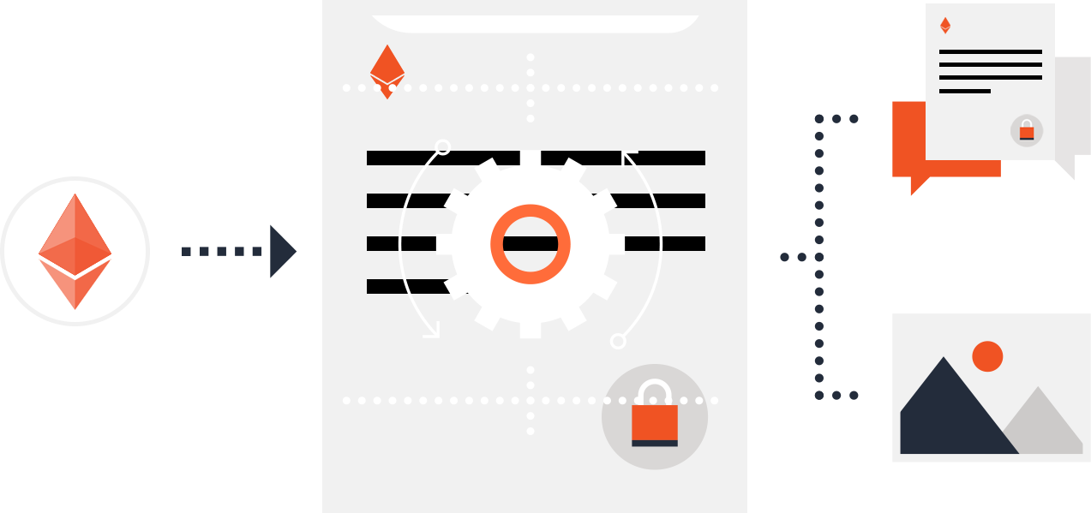
Sending a transaction to a contract causes its code to execute. Contracts can store data, send transactions and interact with other contracts.
ETHER IS THE FUEL

Slide 29
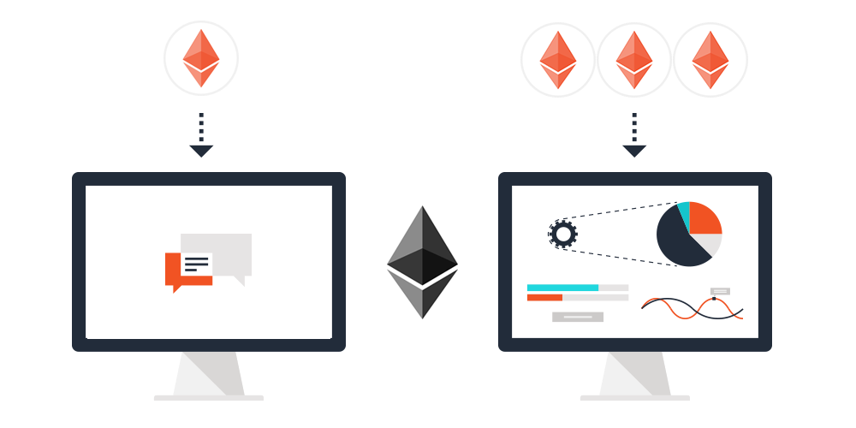
The more computation a transaction requires the more ether it consumes.
NOT ALL CONTRACTS ARE ALIKE

Slide 30
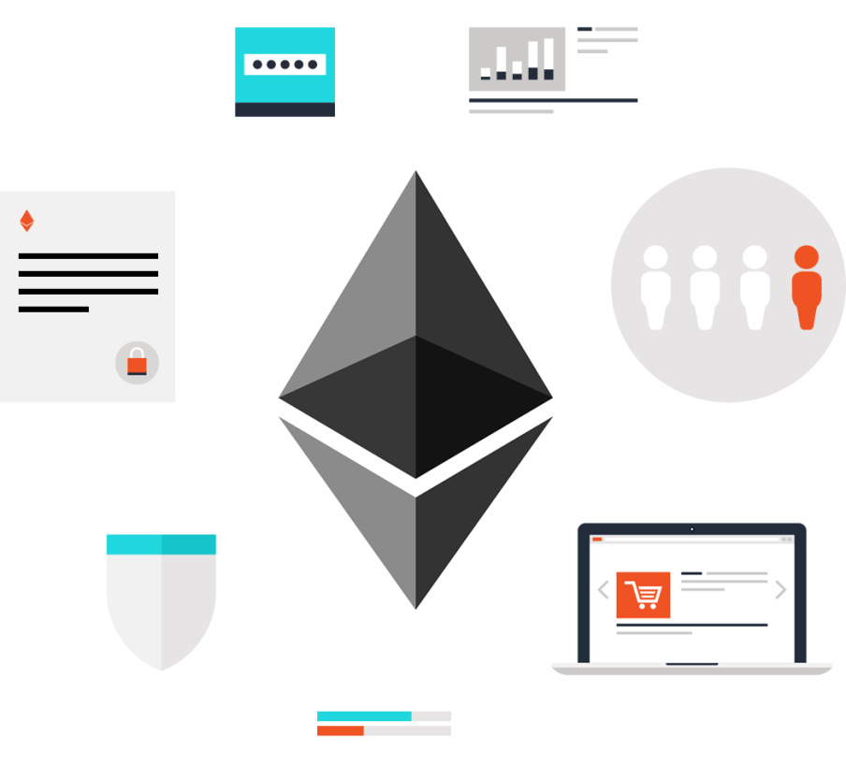
Ethereum can be used to codify, decentralize, secure and trade almost anything.
BUILD (ALMOST) ANYTHING

Slide 31
To research, design and build software that, as best as possible, facilitates, in a secure, decentralised and fair manner, the communication and automatically-enforced agreement between parties.
Notes:
mission statement

Slide 32
To research, design and build software that, as best as possible, facilitates, in a secure, decentralised and fair manner, the communication and automatically-enforced agreement between parties.

Slide 33
To research, design and build software that, as best as possible, facilitates, in a secure, decentralised and fair manner, the communication and automatically-enforced agreement between parties.

Slide 34
Legal Connection
Depends very much on development and uses(liability etc)
Is there someone responsible?
Focus: Empowerment vs Control
Privacy
Dissemination of information
Notes:
There a many connections between a decentralized “World Computer” or blockchains in general and the legal world. Much is however not unknown as it would depend very much on specific implementations and how they are actually used, so this essay is going to stay relatively general.
This ranges from the more practical ones, like liability toward the more implicit ones that are the topics of this essay. Many of these might not be an issue at all (e.g. instead of having a ‘law of the horse’ the existing laws could be applied, reinterpreted or slightly modified to fit the evolving digital world, including new kinds of connected computers. Though, in the end, this also depends on the applications that will evolve and that (or if) will be popular. From liability in general this is also connected more concrete laws such as save harbout provisions, and whether users or their computers qualify under safe harbor rules, and by extension to obligations that a regulator might impose on the system or the people running. But in any case, this is interesting but mere speculation at this point due to no regulatory interest and uncertainty which kind of application, if any will be most popular.
In relation to concrete examples, a good one in the context of either empowerment as opposed to control laws regarding privacy and dissemination of information are a good example.
This is because it can be easily used to show both a case of empowerment and of control.
As a consequence, this article will not focus on the potential liability of users operating ethereum nodes, whether they would have certain obligations towards the use their computer facilitates (although they can’t really control it, it’s all automatic), not on the ethereum world computer and its implementation as such, but the use the it can be made of.
Generally, in one way it could be used to facilitate individual empowerment through the inherent transparency of a public blockchain and the traceability/accountability that the storage and execution of algorithms in a public database allows for. On the other hand, especially visible in the course of discourse regarding Internet of Things and these kind of developments, it signifies a development towards more control of information and connected devices, and by extension reality. This could be mitigated or worked around, but only when it is thought of at creation or update of the algorithms and they are not only designed to ‘just work’ without thinking about this or even designed with the motive of surveillance.

Slide 35
Legal Connection (2)
Empowerment:
Accountability of algorithms
Control
Internet of Things, possibly more control
Necessary to think of emp. At creation of code

Slide 36
smart contract
contract NameReg {
mapping (address => bytes32) names;
function register(bytes32 name){
names[msg.sender] = name;
}
function getName(address addr) returns (bytes32 name){
return names[addr];
}
}
Notes:
Smart contract example, with nothing lega at all ☺

Slide 37
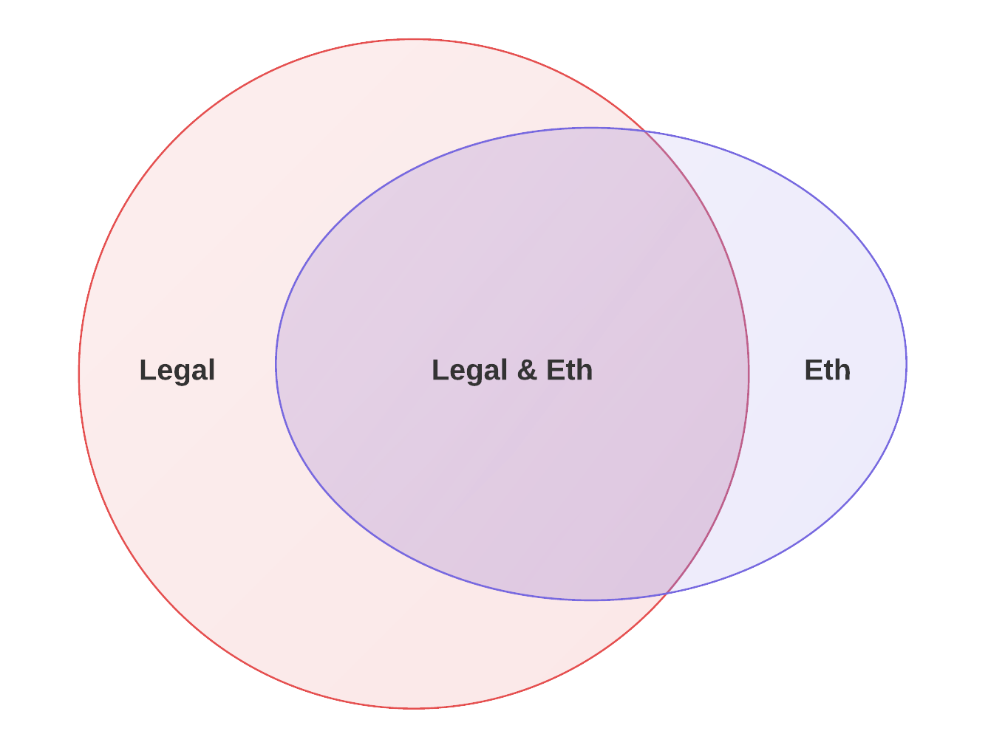
Somewhat „legal“

Slide 38
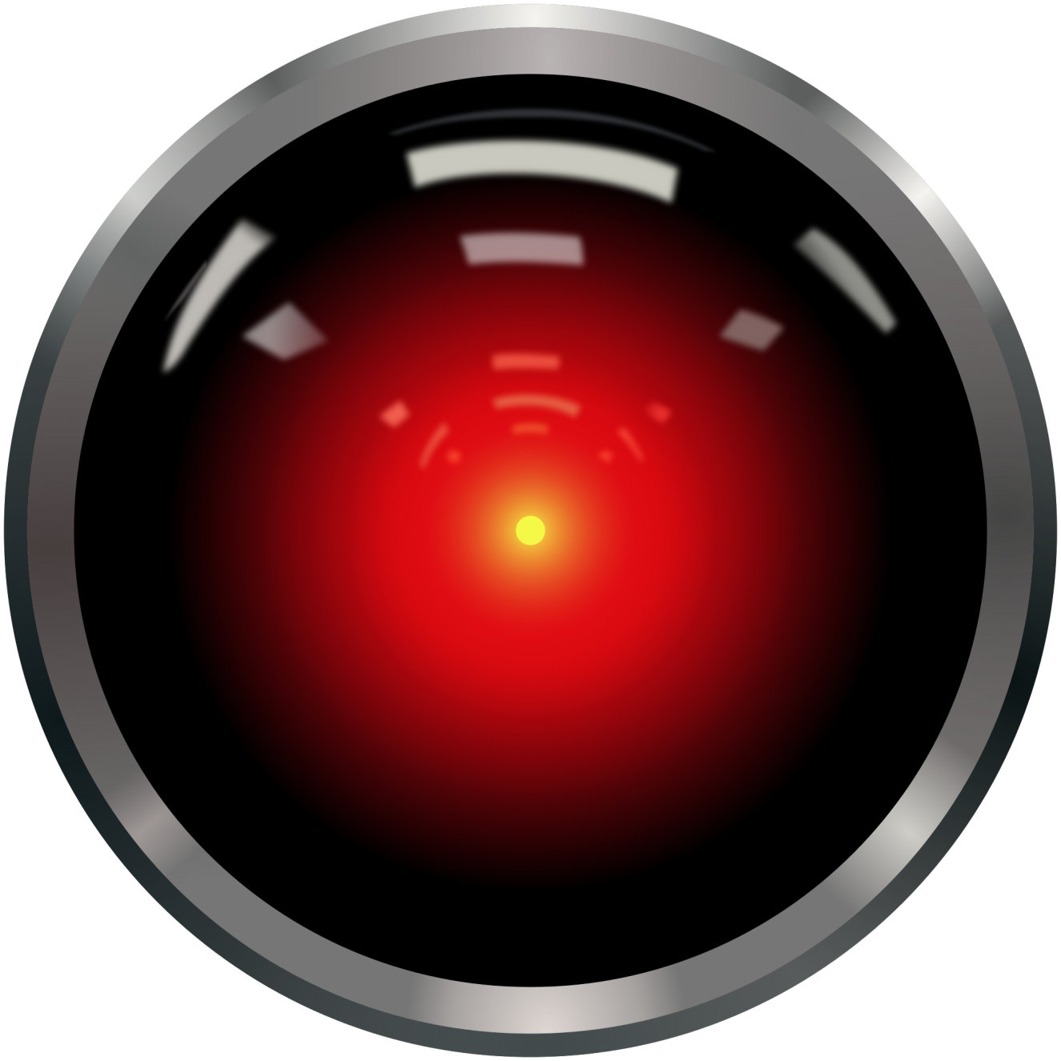
Analysis / So what?

Slide 39
„It was just that hackers and programmers were good with computers. Then everything became a computer.“
(unknown Twitter user)

Slide 40
Utopia
transparency,
Individual empowerment
Egalitarian use of technology
The (equalizing/disrupting) power of the Ethereum World Computer and the Blockchain

Slide 41
Ideally:
(Social) networks that with transparent algorithms bound to the law and interwoven with technology and legal requirements, to always know what is going on
Requires new approach to law and tech making
THEN this would be empowering

Slide 42
BUT
Potential for disruption,
Liable to new sources of power imbalances
Maybe just shifting power

Slide 43
Dystopia
New power imbalances / as with sharing economy, just shifting instead of true disruption
Economic incentives/processes (mining, fees)
Pot. Reinforce / ingrain market (capitalist) processes into structures/institutions built on blockchain (arbitration, social network…)
More control instead of empowerment

Slide 44
BUT
Just makes influences and interactions more visible (ideally)
Result: Depiction of algorithms and results in blockchain, transparent view of results and influences (even the economic incentives/processes) that led to the result.

Slide 45
Sci-Fi Stats
Not many direct points of comparison between movies and Ethereum/Blockchains
Likelies: Brazil, FAQ (Sisterhood of Metacontrol), Alphaville, Metropolis

Slide 46
Further Research
When using a system as Ethereum – with more self-control over contract and by extension over legal agreements, does this change a persons‘s relationship to the law or the law itself?
Include more sci-fi ☺
Should we tell more utopia or is dystopia necessary?

Slide 47
Works for further research

Slide 49
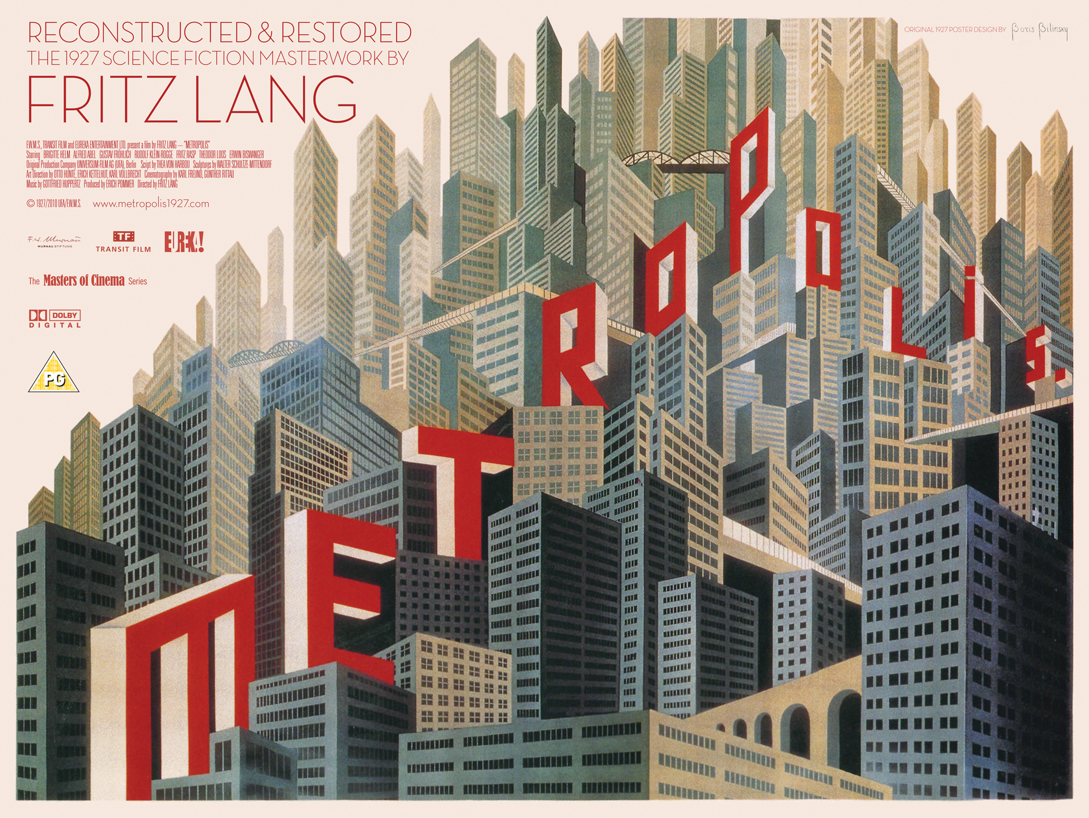

Slide 50
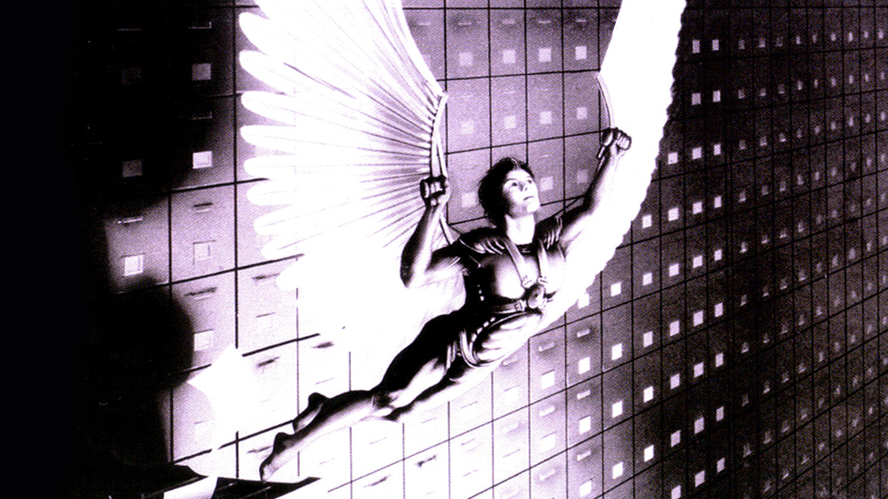
Brazil

Slide 51
Quo vadis, world computer?
Dystopia or Utopia? Or both?

Slide 52
Notes:
Like to end with this, shows very well the contrast between dystopia and utopia, from a german rap group‘s latest album where most songs in a way are about the world ending, but saying this is a good thing because we are leaving indystopia already, so it can only get better, as illustrated by this picture.

Slide 53
Contact
Florian Idelberger (LL.M)
European University Institute
florian.idelberger@eui.eu
@windrush

