Slide 1
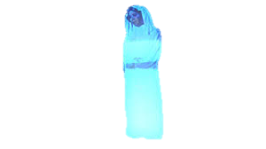
Holograms and the law: a multidimensional issue
Presentation for Giiki-2015
Philippe Jougleux, associate professor, Law dept., European university of Cyprus.
Tatiana-ELENI Synodinou, associate professor, law dept., university of Cyprus.

Slide 2
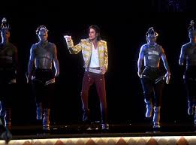
The reality of holograms
Hologram of Tupac Shakur,
2012 Coachella Valley Music & Arts Festival
Hologram of Micheal Jackson,
2014 Billboard Music Awards

Slide 3
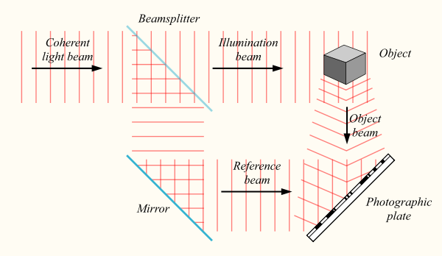
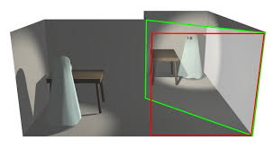
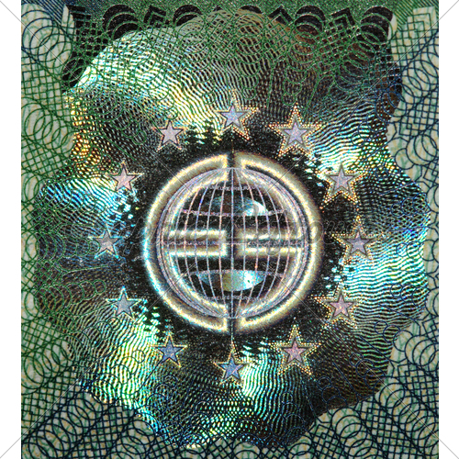
About “true” and “false” holograms
Real holographic technology
Pseudo Holograms
Real holographic technology
Illusion of 3D images
Recording a hologram, source wikipedia
The classic Pepper’s Ghost illusion

Slide 4
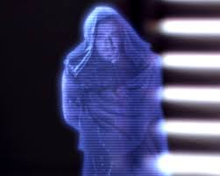
Our Presentation’s topics
Copyright law
Industrial property law
Image right

Slide 5
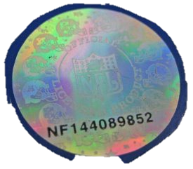
1. Holograms and Copyright law
The hologram as a tool for Copyright law enforcement
Not true anymore ! Nowadays costs of holograms’ cloning are low.
Legal protection of holograms :
“Rights management information”
Original work of mind

Slide 6
“Pseudo- holograms” and right to communication to the public
Real actor
Pepper’s Ghost illusion
Holographic performance
Computer generated imagery
combination and synthesis of images and sounds deriving from various existing performances of the artist !

Slide 7
2. Holograms and industrial property law
The issues
Patent Law
Patent war on the technology
Trade mark Law
The impossible graphic representation
… But is it really an invention?

Slide 8
Holograms and Patent law
Patentable intention
Invention
with industrial applications
new
inventive step
Invention vs Discovery
Light as a wave = discovery
Recording through a powerful laser= invention
pepper’s ghost illusion, discovery or illusion?
Huge commercial potential of Pseudo holograms
Already well known = public domain
Sci-Fi influence?
A step ahead of the state of the art.
A combination of old technologies could be seen as an inventive step, while not if is just a juxtaposition of techologies

Slide 9
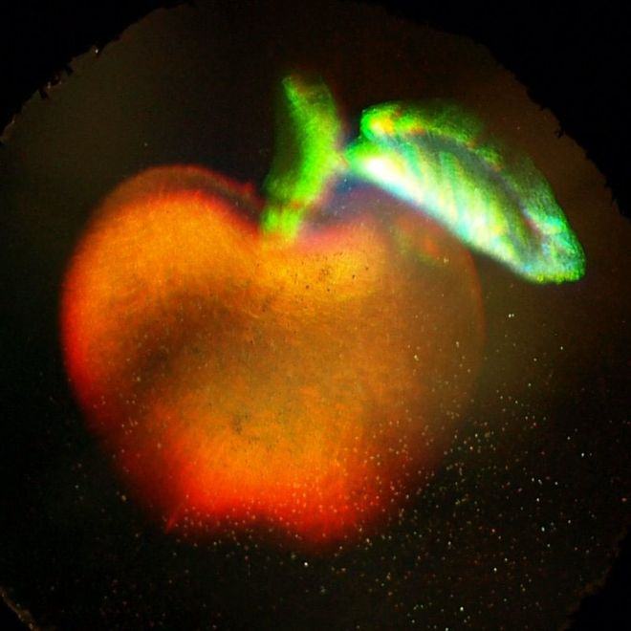
The hologram as 3d trademark
landmark decision Sieckmann (Case C-273/00)
A graphic representation should be clear, precise, self-contained, easily accessible, intelligible, durable and objective

Slide 10
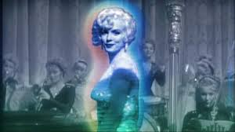
3. Hologram and the right to image
Control over the image of a deceased person ?
US => some States recognize statutory or common law post mortem publicity rights
Europe
Germany : descendibility of the economic aspects of personality rights
France : extinguished at the death of the person
UK : no particular protection but possible application of the torts of breach of confidence or passing off
The only sure solution : the image as a well known trademark !

Slide 11
Conclusion
Too much complexity
A web of distinct legal frameworks
A solution?
A right to virtualization

Slide 12
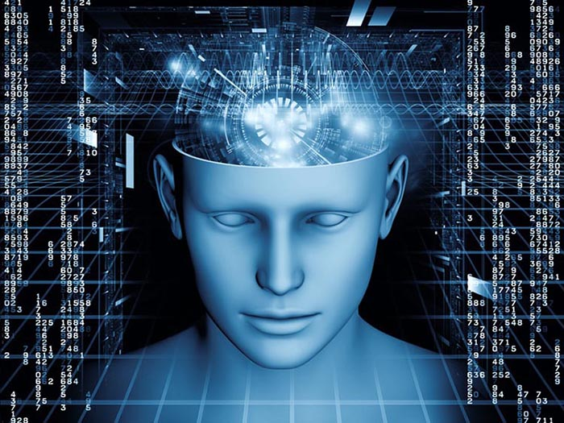
Conclusion
Many thanks for your attention !

