Slide 1
Security and Privacy for the Internet of Things - Not
Miranda Mowbray, HP Labs
miranda.mowbray at hpe.com
My opinions, not my employer‘s

Slide 2
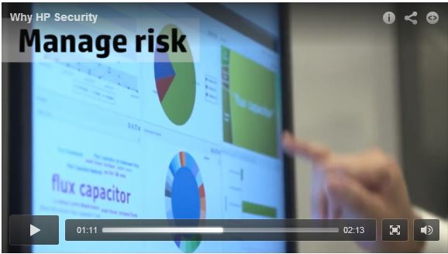
Still from HP marketing video

Slide 3
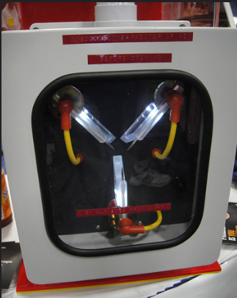
Photo from San Diegi Comic-Con 2011 Doug Kline / popculturegeek on Flickr
https://www.flickr.com/photos/popculturegeek/6039791556/

Slide 4
Internet of Things Research Study by Craig Smith and Daniel Miessler HP Security Research (Fortify, not HP Labs) 10 most popular IoT devices in different categories: TV, webcam, home thermostat, remote power outlet, sprinkler controller, hub for controlling multiple devices, door lock, home alarm, scales, garage door opener Report linked from http://go.saas.hp.com/fod/internet-of-things

Slide 5
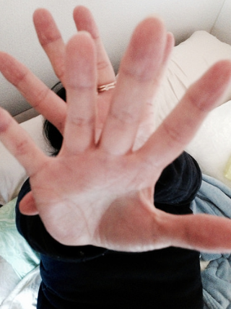
Photo Kimubert / treevillage on Flickr,
https://www.flickr.com/photos/treevillage/16019902595/

Slide 6
Internet of Things Research Study: privacy
9 collected at least one piece of personal information via the device, its cloud, or the app
Eg. name, address, date of birth, health data, even credit card numbers

Slide 7
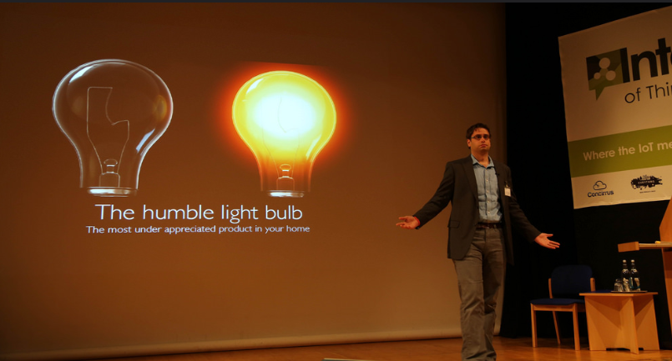
How many Pen Testers does it take to change a lightbulb?
Photo of George Yianni Betsy Weber / betseyweber on Flickr
https://www.flickr.com/photos/betsyweber/13952214021/

Slide 8
Internet of Things Research Study: authentication
8 failed to require passwords of sufficient complexity or length.
Most allowed eg. “1234” or “123456”

Slide 9
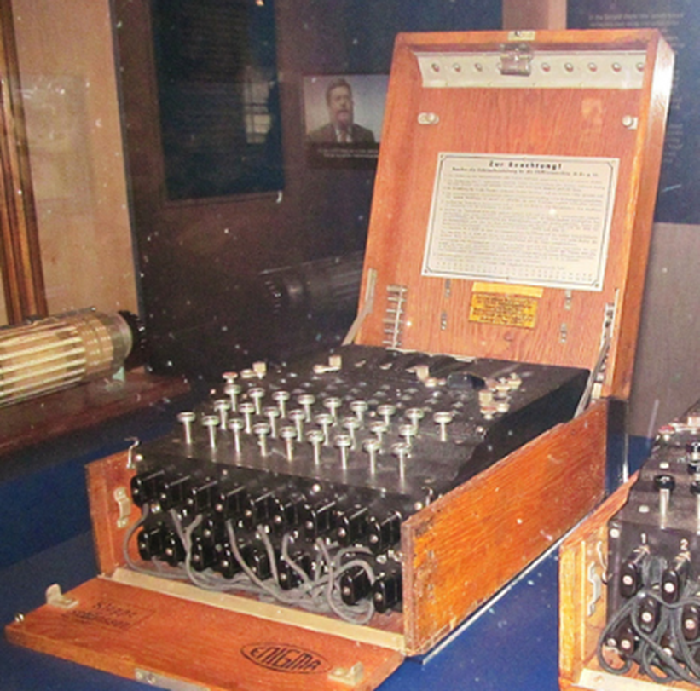
Photo DAVID HOLT / zongo on Flickr,
https://www.flickr.com/photos/zongo/9392549871/

Slide 10
Internet of Things Research Study: encryption
7 had unencrypted communications with Internet or local network.
Half of mobile apps had unencrypted communications.

Slide 11
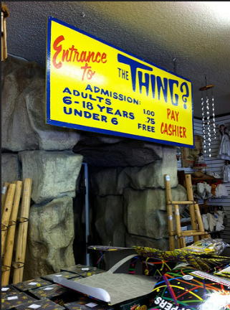
Photo Casey Fiesler / cfiesler on Flickr,
https://www.flickr.com/photos/cfiesler/5798190451/

Slide 12
Internet of Things Research Study: Web user interface
6 had user interface security problems
eg. persistent XSS, poor session management, weak default credentials, credentials transferred in clear

Slide 13
Detail of image Stephen Edgar/netweb on Flickr,
https://www.flickr.com/photos/netweb/3825893890/

Slide 14
Internet of Things Research Study: software updates
6 didn’t used encryption to upload software updates. Some updates could be intercepted and the whole code viewed and changed.

Slide 15
25

Slide 16
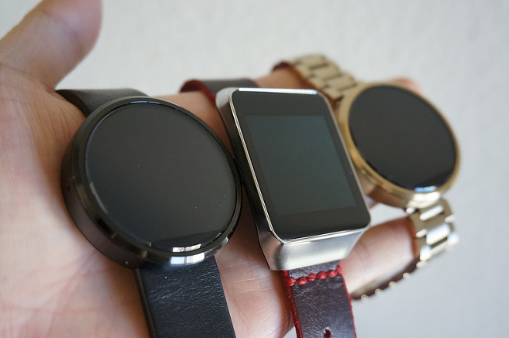
Photo Intel Free Press /intelfreepress on Flickr,
https://www.flickr.com/photos/intelfreepress/16539020590/

Slide 17
Smartwatches 2015 report 10 of the top smartwatches in today’s market Android or iOS mobile device and app Report linked from http://go.saas.hp.com/fod/internet-of-things

Slide 18
9 of 10: watch communications trivially intercepted
7 of 10: firmware transmitted without encryption

Slide 19
How Safe are Home Security Systems? 2015 report 10 off-the-shelf home security systems 7 with cloud interface, all with mobile interface Report linked from http://go.saas.hp.com/fod/internet-of-things

Slide 20
10 of 10 vulnerable to brute-force password-guessing attack
Other problems too

Slide 21
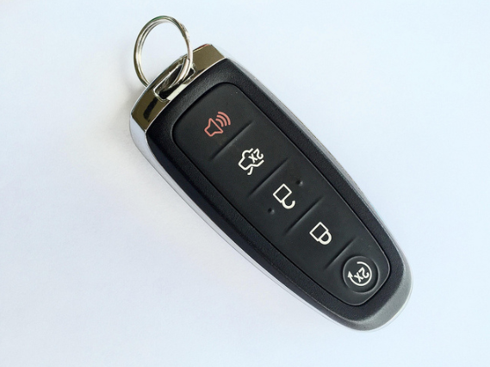
Photo of Ford keyless fob ckramer on Flickr
https://www.flickr.com/photos/ckramer/16536075774/

Slide 22
Keyless car theft
London, 2014: 42% of all vehicle thefts (= 6000)
Verdult, Garcia & Ege, 2013, publ. 2015
https://www.usenix.org/sits/default/files/sec15_supplement.pdf
Metropolitan Police, 2015
http://content.met.police.uk/Article/What-is-keyless-vehicle-theft/1400029057620/
The Mirror, 2015
http://www.mirror.co.uk/news/uk-news/crime-wave-sweeping-nation-car-5113289

Slide 23
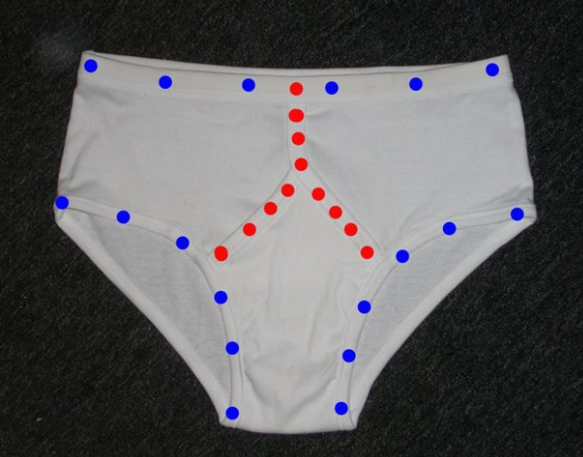
Disco Pants o0mouse0o aka Russell Couper, Coupertronics
http://www.instructables.com/id/Disco-pants/

Slide 24
Why is IoT privacy & security so pants?
New tech
Hooking up old tech
Limited device resources
Not even trying
Image adapted from Fail stamp Nima Badiey/ ncc_badiey on Flickr,
https://www.flickr.com/photos/ncc_badiey/3095099782/

Slide 25
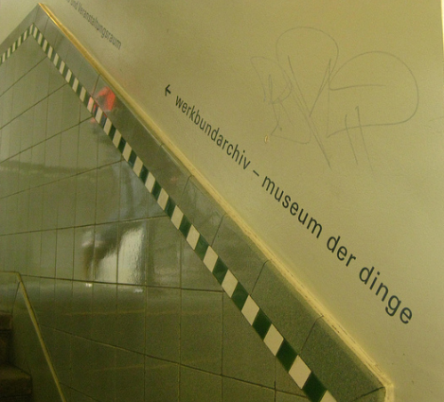
Museum of Things, Berlin, photo fiona.mcgowan / freeeeb on Flickr
https://www.flickr.com/photos/freeeeb/4486673826/

Slide 26
Some Suggestions
Don’t fund insecure Things
Open source kit for hooking up offline Things
Security development processes
Process for responding to vuln report
Overrides
Business models
Lawyers

Slide 27
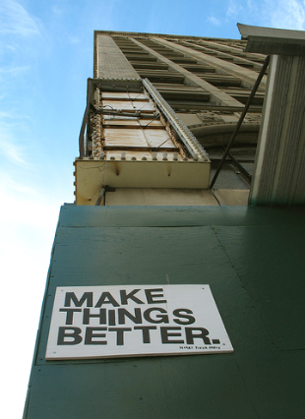
Photo of Secret Pizza Party poster in Detroit CAVE CANEM/bewareofdog,
https://www.flickr.com/photos/bewareofdog/284770877/

Slide 28
Questions?
Miranda Mowbray, HP Labs
miranda.mowbray at hp.com (hpe.com from 1 Aug 2015)

Slide 29
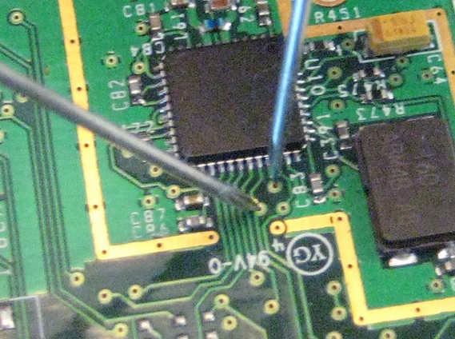
ZigBee Sniffing
Photo Travis Goodspped / travisgoodspeed on Flickr
https://www.flickr.com/photos/travisgoodspeed/3351125516/

Slide 30
ZigBee Exploited
“Tests with light bulbs and even door locks have shown that the vendors of the tested devices implement the minimum of the features required to be certified, including the default TC fallback key."
Tobias Zillner, Cognosec, “ZigBee Exploited”, 6 Aug 2015
http://cognosec.com/zigbee_exploited_8F_Ca9.pdf

Slide 31
Physiological data (not comprehensive) Blood Pressure Ihealth, Withings Movement Fitbit, Nike Fuel band, Jawbone up band, Garmin, Samsung, MC10, Zephyr, Withings, Spire, iHealth, Jins Merne, Proteus, Neumitra, Body Media, Empatica, Owlet Muscle Activity Athos Skin Conductance Basis, Body Media, Empatica, Neumitra Oxygen Level iHealth, Withings, Owlet Posture Lumo, Zephyr, Jins Merne Hydration Corventis, MC10 Temperature Tempdrop, Empatica, BodyMedia, Basis, Owlet, MC10 Sleep Fitbit, Rest devices, Garmin, Nike, Amigo, BodyMedia, Withings, Samsung, Misfit, Jewborne, iHealth, Basis, Owlet Brain activity NeuroSky, DAQRI, Emotiv Glucose Google, Dexcom, Glysens Inc Respiration Spire, Zephyr, Rest Devices Ingestion Proteus Eye Tracking Jins Merne Heart tracking Zephyr, Withings, Sprouting, Proteus, iHealth, Basis, Cofventis, AliveCor, Samsung, Garmin, Empatica, Owlet
Source: Elenko, Underwood + Zohar, Nature Biotechnology 33: 456-461, May 2015
http://www.nature.com/nbt/journal/v33/n5/fig_tab/nbt.3222_F1.html

Slide 32
OWASP recommendations: privacy
Only collect data the device needs to function
Try not to collect sensitive data
De-identify or anonymize
Ensure the Thing and its components protect personal information
Only give access to authorized individuals
“Notice and Choice” for end-users if more data is collected than would be expected
Open Web Appllication Security Project (slightly edited)
https://www.owasp.org/index.php/OWASP_Internet_of_Things_Top_Ten_Project

Slide 33
OWASP recommendations: authentication
Require strong passwords
Granular access control where necessary
Protect credentials
2-factor authentication where practical
Secure password recovery mechanisms
Re-authentication for sensitive features
Password control configuration options
Open Web Appllication Security Project (slightly edited)
https://www.owasp.org/index.php/OWASP_Internet_of_Things_Top_Ten_Project

Slide 34
OWASP recommendations: transport encryption
Encrypt data when transiting networks
Use SSL/TLS, or other industry standards if these are not available
Don’t use proprietary encryption
Open Web Appllication Security Project (slightly edited)
https://www.owasp.org/index.php/OWASP_Internet_of_Things_Top_Ten_Project

Slide 35
OWASP recommendations: Web user interface
Change default passwords during initial setup – ideally also default usernames
Robust password recovery mechanisms
Ensure not susceptible to XSS, SQLI, CSRF
Don’t expose credentials in network traffic
Require strong passwords
Lockout account after 3-5 failed logins
Open Web Appllication Security Project (slightly edited)
https://www.owasp.org/index.php/OWASP_Internet_of_Things_Top_Ten_Project

Slide 36
OWASP recommendations: software/firmware updates
Ensure updates are possible!
Encrypt the update file
Transfer update over encrypted connection
Ensure update file doesn’t expose sensitive info
Verify update before uploading and applying
Secure the update server
Open Web Appllication Security Project (slightly edited)
https://www.owasp.org/index.php/OWASP_Internet_of_Things_Top_Ten_Project

Slide 37
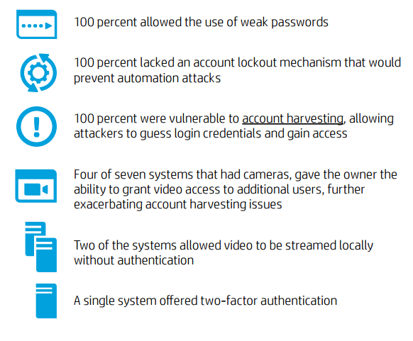

Slide 38
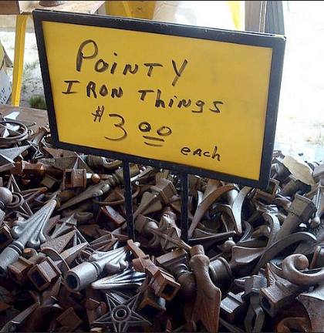
Photo Jim / albysbrain on Flickr,
https://www.flickr.com/photos/albysbrain/5951283280//

Slide 39
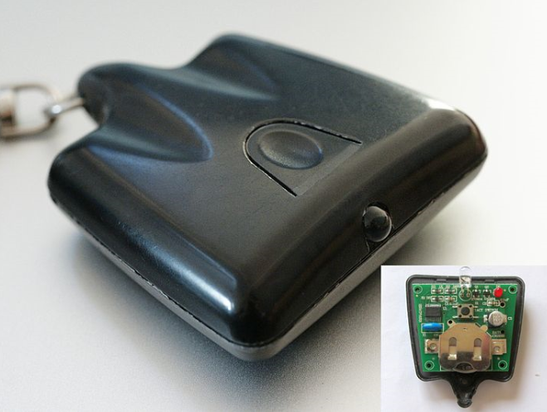
Photo of TV--B-Gone Stefan Bellini on Wikipedia
https://en.wikipedia.org/wiki/TV-B-Gone#/media/File:TV-B-Gone_complete.jpg

Slide 40
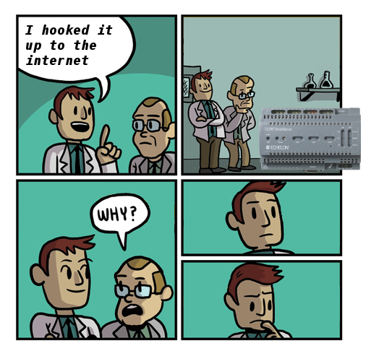
By Dan Tentler (@Viss on Flicker), posted on Twitter 27 June 2015, https://twitter.com/Viss/status/614867241922736129/photo/1
Adapted from a comic by C K Green, http://gunshowcomic.com/513

Slide 41
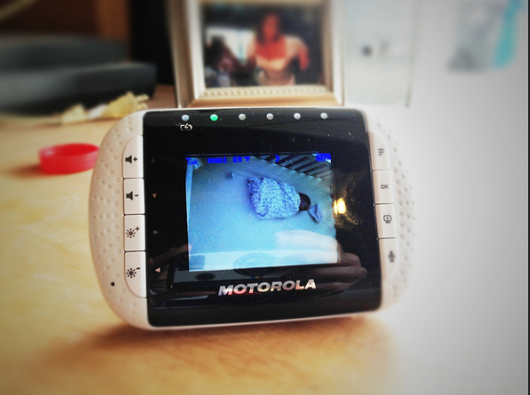
Vendor Response: baby monitors
Photo Wade Armstrong/juniorbird on Flickr
https://www.flickr.com/photos/juniorbird/8524443211/

Slide 42
10 vulnerabilities reported to 7 vendors
Philips N.V. “exemplary” response
No other vendor gave estimated timeline for fixes
“Some vendors did not respond to the reported findings at all. Others responded with concerns about the motives behind the research, and were wondering why they should be alerted or why they should respond at all.”
Mark Stanislaw & Tod Beardsley, Rapid7, Sept 2015, “Hacking IoT: A case study on baby monitor exposures and vulnerabilities
https://www.rapid7.com/docs/Hacking-IoT-A-Case-Study-on-Baby-Monitor-Exposures-and-Vulnerabilities.pdf

