Slide 1
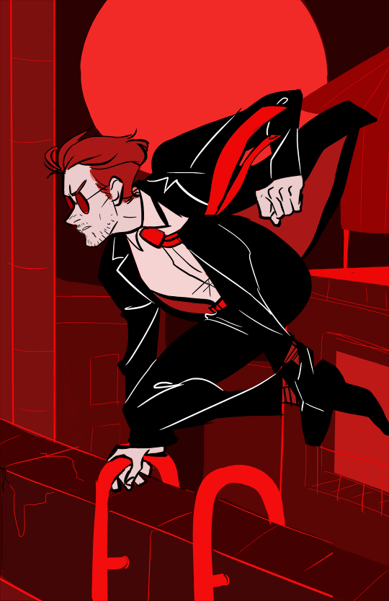
Conceptions of Privacy in the Marvel Universe
Or how daredevil cured a hole in my life stomach

Slide 2
Justifications
Always being told the young have no conception of privacy (Zuckerberg) or that they do but different from “ours” (boyd)
Marvel films immensely popular
What do they say about what we – and especially young – think about privacy and identity?
March 2014: Cpt America 2 : the Winter Soldier as the first post-Snowden privacy and anti NSA movie (Snowden, June 2013)
(Still true? Citizen 4 is a documentary..)

Slide 3
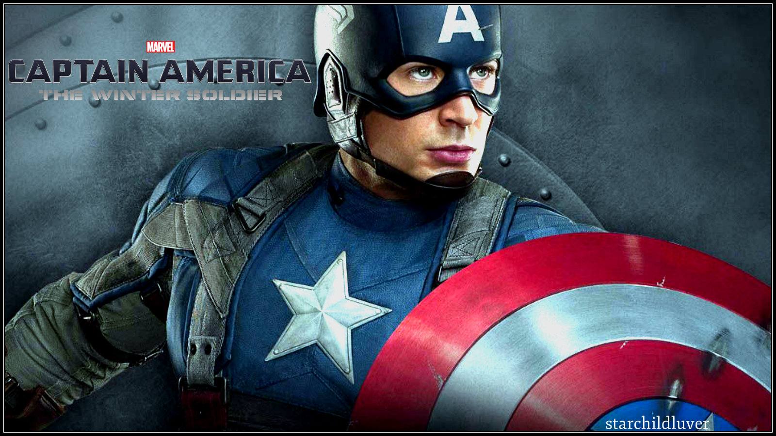
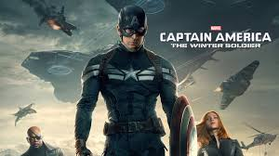

Slide 4

Clips
1. Project Insight - Freedom or fear?
2. Zola’s algorithm!
3. Poor defense of privacy 1
4. Poor defense of privacy 2
5. “Because you need us.”

Slide 5
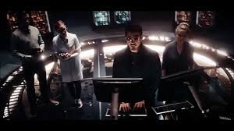
Does the code of the Marvel universe encourage surveillance?

Slide 6
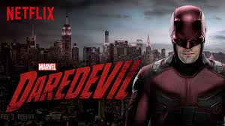
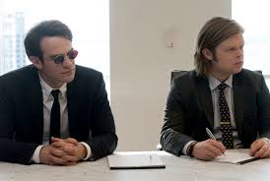
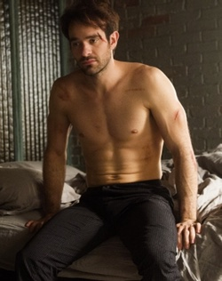
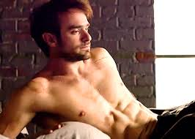
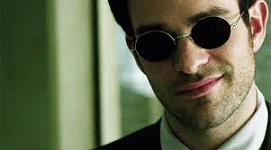
Daredevil - Netflix

Slide 7
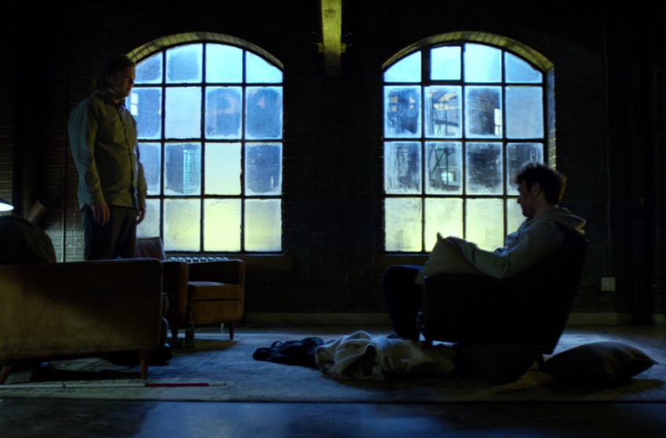
Daredevil (Netflix, 2015): Nelson v Murdock
That's how you knew Karen was telling the truth... when we first met her at the precinct.
Yeah.
You listened to her heartbeat without her permission? We're lawyers! You can't do that!

Slide 8
Daredevil and (secret) identity (the law bit)
Real names policies
Edwards “From the Fantasy to the Reality: Social Media and Real Name Policies”
FB – foreign names (Gaelic? ), drag queens, discrimination vs trans people, Native Americans
More serious cases : escaping violent ex es, fearing the sack, civil servants, academics, political dissidence ..
The fantasy: Online world was meant to be one where the “I” could be escaped – gender bending, VW avatars etc
Vs The reality: being tied to one identity for security and monetisation
Facebook’s real name policy increasingly enforced despite bad PR (G+)
HL Select Committee had to be talked out of recommending mandatyory real names policy online (2014)
“[The policy] helps keep people safe,” said Zuckerberg. (July 2015)
Germany – Hamburg DPA demanded people be allowed to use pseudonyms on FB ; may win despite Irish jurisdiction over FB (? ) following Google Spain case
England – Nightjack case v Times (2009) – is being a superhero an “inherently public activity”? So outing not a breach of confidence?

Slide 9
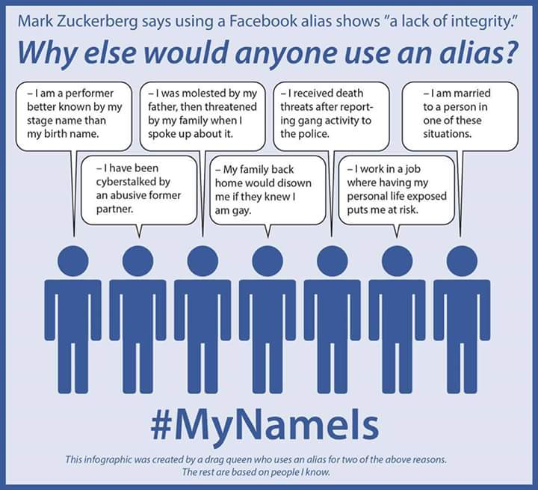

Slide 10
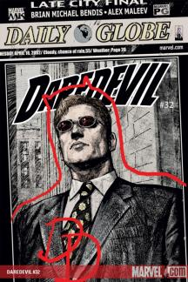
Wht do the comics say about identity and secrecy?
Bendis and Maleev Daredevil 16-81, 2001-2006 – “Out”
Brubaker etc Daredevil 82-, 2006-2009
Waid and Samnee (etc), Daredevil 1-36/1-18 , 2011 - September 2015

Slide 13
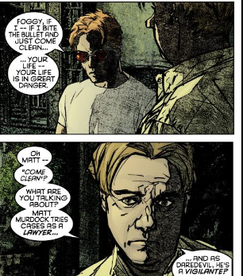

Slide 14
The trial of the White Tiger

Slide 15

(2006 – Brubaker)

Slide 16
Back in the closet.. And out again
“Murdock papers” storyline – DD’s secret identity is restored, sort of.. (not by magic or technology, but by declaring the outing an “FBI frame”)
Change of writers
Bendis (Brubaker) – identity was about being able to be yourself under the cover of darkness. Secrecy as self.
(Morrison – is Superman pretending to be Clark Kent , or is Clark Kent pretending to be Superman?)
Waid – identity is about being yourself to everyone. Living a whole identity. Being “out”. Also openness tied to good mental health, secrecy to depression.

Slide 17
Self-outing … or taking yourself for an outing?

Slide 19
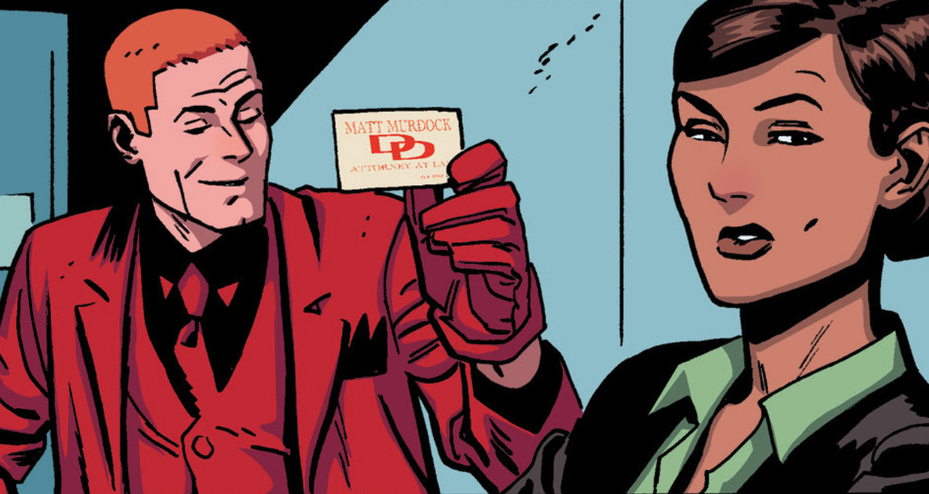

Slide 20
Last issue of Waid run, Sept 15

Slide 22
