Slide 1
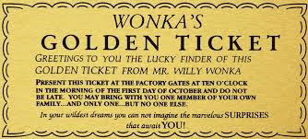
A golden ticket? Uber, Airbnb and the Chocolate Factory of the sharing economy Catherine Easton

Slide 3
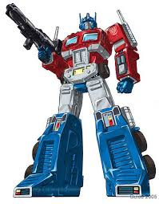
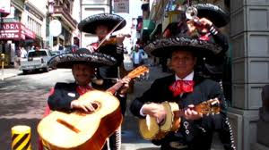
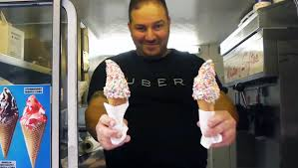
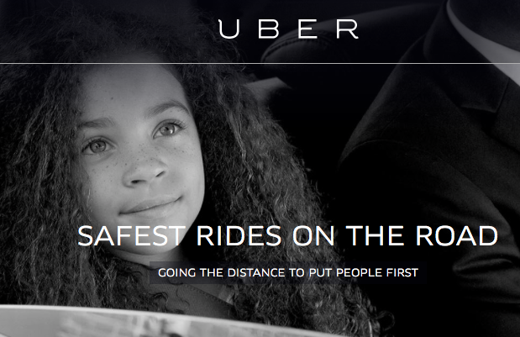
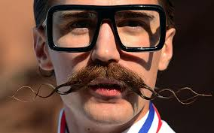

Slide 4
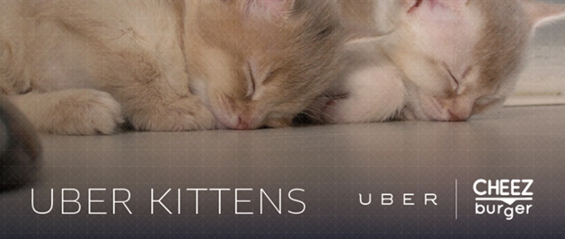
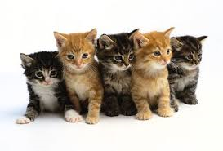

Slide 5
“The cost of physical capital was for more than 150 years the central organizing principle of information and cultural production, from the introduction of high-cost, high-volume mechanical presses, through telegraph, telephone, radio, film, records, television, cable, and satellite systems. These costs largely structured production around a capital-intensive, industrial model. The declining price of computation, however, has inverted the capital structure of information and cultural production”. (Benkler 2002)

Slide 6
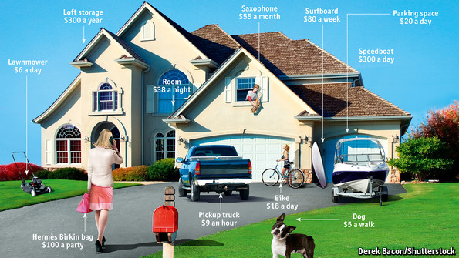

Slide 7
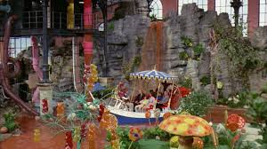

Slide 8
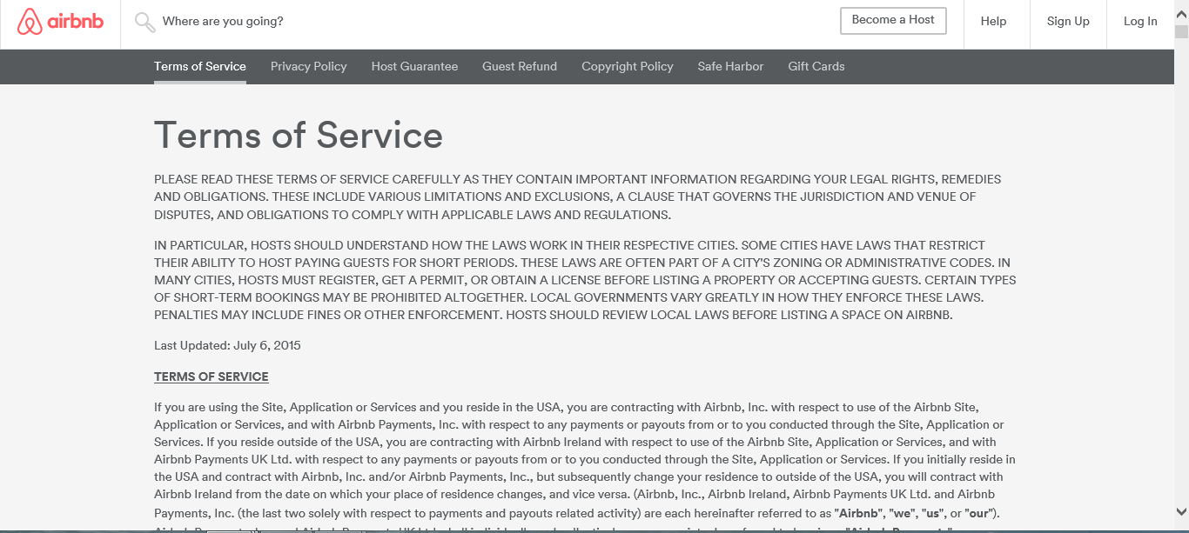
https://www.youtube.com/watch?v=MCrXva4DTtE
Notes:
https://www.youtube.com/watch?v=MCrXva4DTtE

Slide 9
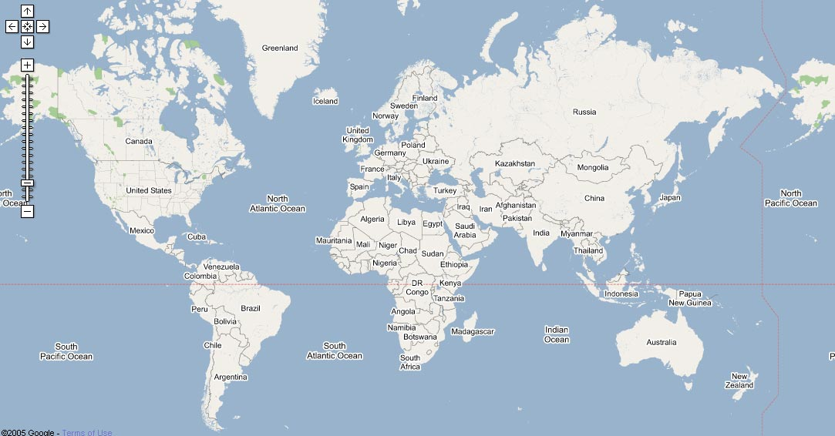

Slide 10
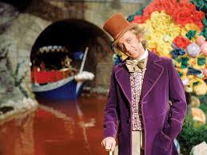
An intermediary
Notes:
https://www.youtube.com/watch?v=SVi3-PrQ0pY 1.30

Slide 11
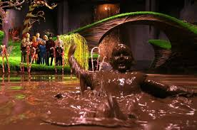
Help! Police! Murder!
UBER SHALL NOT BE LIABLE FOR INDIRECT, INCIDENTAL, SPECIAL, EXEMPLARY, PUNITIVE, OR CONSEQUENTIAL DAMAGES, INCLUDING LOST PROFITS, LOST DATA, PERSONAL INJURY, OR PROPERTY DAMAGE RELATED TO, IN CONNECTION WITH, OR OTHERWISE RESULTING FROM ANY USE OF THE SERVICES, EVEN IF UBER HAS BEEN ADVISED OF THE POSSIBILITY OF SUCH DAMAGES.
*Please note that Airbnb has no control over the conduct of Hosts and disclaims all liability. Failure of Hosts to satisfy their responsibilities may result in suspension of activity or removal from the Airbnb website.
Notes:
https://www.youtube.com/watch?v=FdSORiSaRW8.20

Slide 12
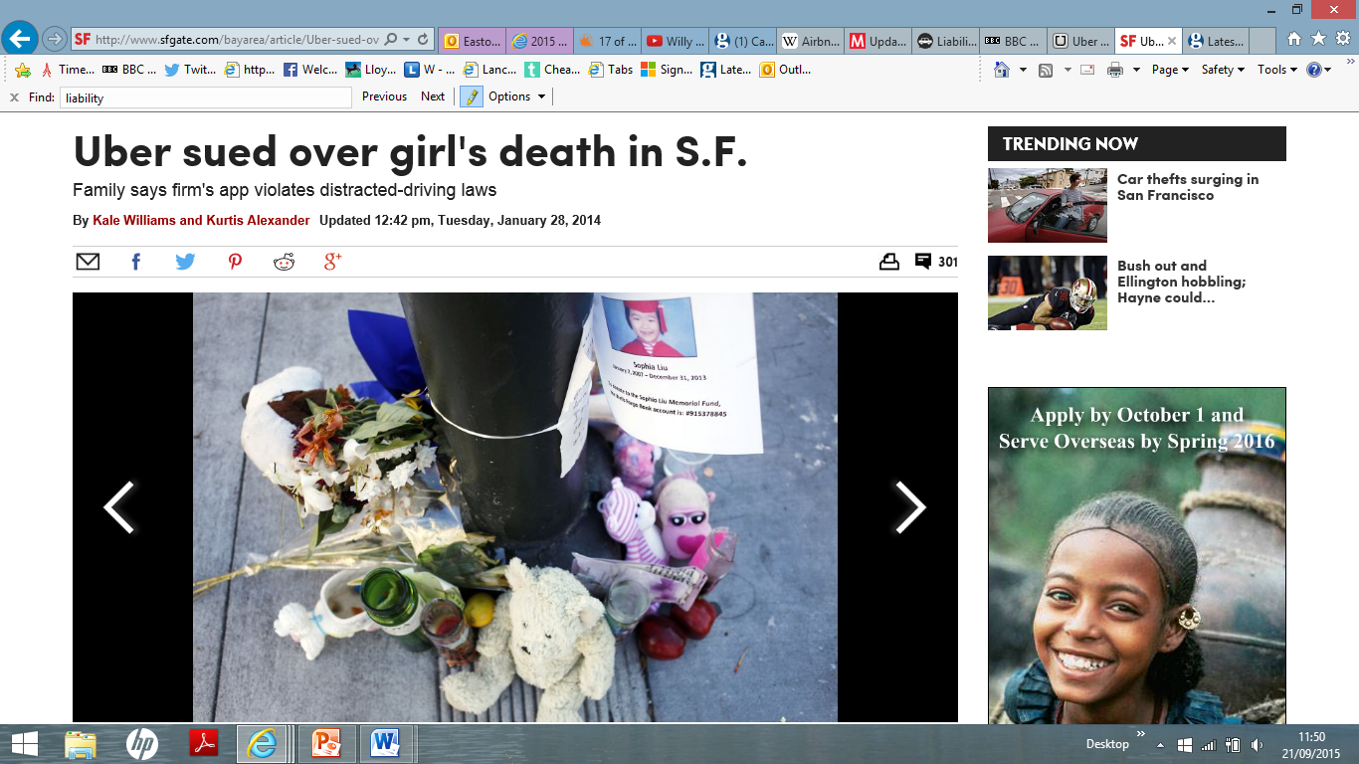
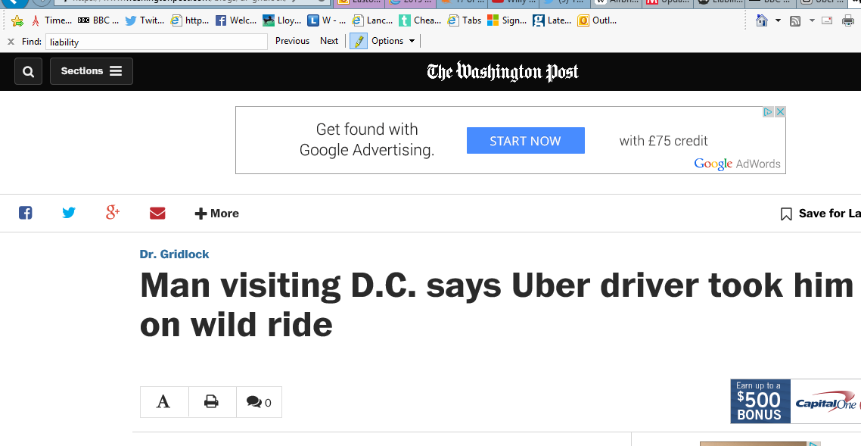

Slide 13
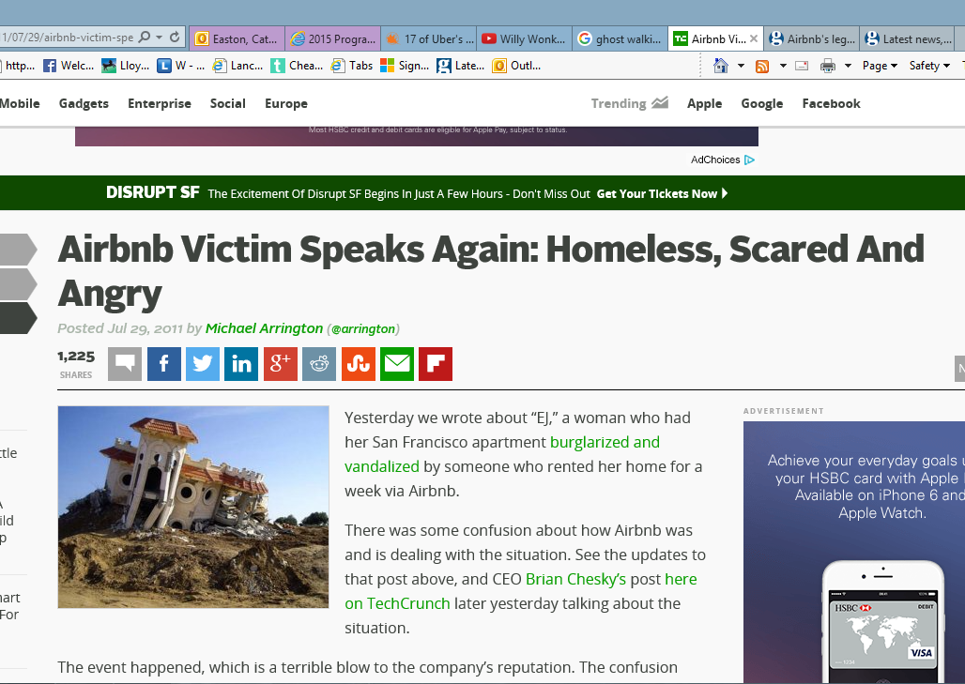
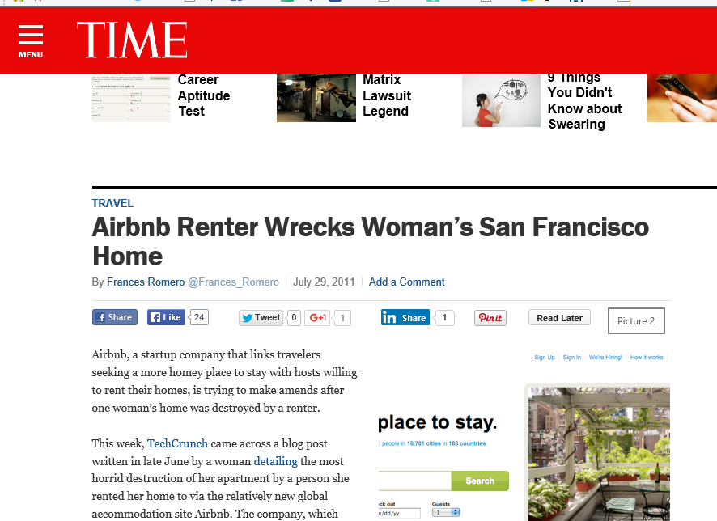
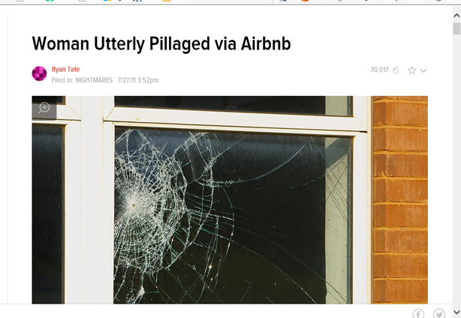
“Emily's call to Airbnb's "urgent" line was ignored for 14 hours… she was only able to get a call back after contacting a friend who happens to freelance for Airbnb”.

Slide 14
urgent@airbnb.com
From: Airbnb Community Support
Date: Fri, Apr 22, 2011 at 11:43 PM
Subject: Request received: Emergency Situation: tenants ruined my apartment and stole things
To: Troy Dayton
— Please respond above this line. —
Thanks for contacting Airbnb community support!
Your request (#124683) has been received, and is being reviewed by our support staff. Please note that, due to an overwhelming number of inquiries, our responses may be delayed. Thank you for your patience.
If this is an absolute emergency, please e-mail urgent@airbnb.com and we’ll get back to you as quickly as possible.

Slide 15
“For some moments in life there are no words. Run along now”.

Slide 16
“’Sharing economy’ companies like Uber shift risk from corporations to workers, weaken labour protections, and drive down wages.” Avi Asher-Schapiro
O’Connor v Uber Technologies, Inc, 2013 WL 6354534
Gillette v. Uber Technologies, Inc.

Slide 18
Uber drivers could look up ride history of individual users or watch them during live trips in “God” view
“With 2.7 billion people now online, we should continue to harness data to help put more certainty into the peer-to-peer marketplace, so that it can continue to grow and thrive. The more trust we have in our peers, the more sharing — and renting and bartering and trading — we’ll all be able to do”.
Stephen Ufford, Founder and CEO of Trulioo, founder of several consumer data focused startups
“Nobody would know it was us.”

Slide 19
Nearly 95% of Airbnb properties boast an average user-generated rating of either 4.5 or 5 stars (the maximum); virtually none have less than a 3.5 star rating. Compare this to TripAdvisor, where there is a much lower average rating of 3.8 stars, and more variance across reviews.
For the cross-listed properties on both Airbnb and TripAdvisor, the paper found that more properties receive the highest ratings (4.5 stars and above) on Airbnb than on TripAdvisor.
January 28, 2015
A First Look at Online Reputation on Airbnb, Where Every Stay is Above Average
Georgios Zervas Questrom School of Business, Boston University
Davide Proserpio Boston University - Department of Computer Science
John Byers Boston University - Department of Computer Science

Slide 21
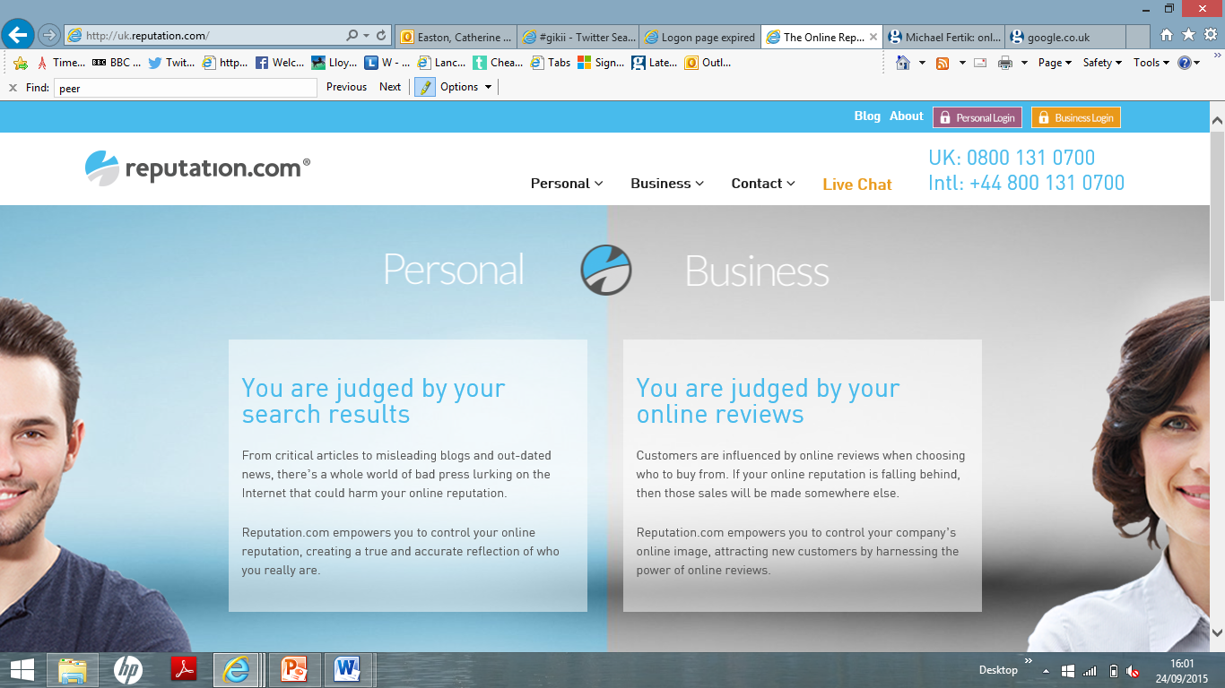

Slide 22
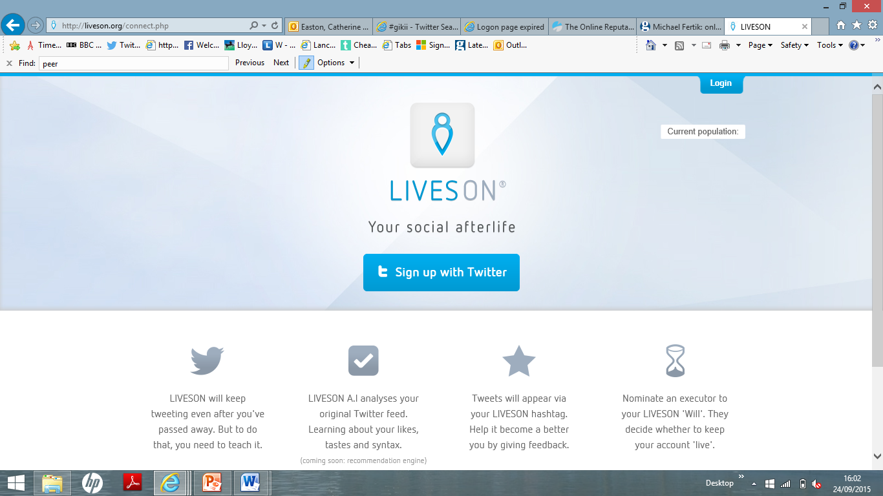

Slide 23
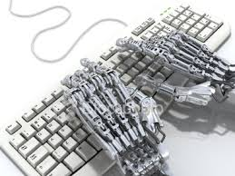

Slide 24
AirBnB algorithm:
3. Guest preferences
• Location relevance. Guests can search broadly at the city level or narrow into specific neighborhoods, so we try to show search results that are most relevant to their location preferences. We may use past booking information to determine which locations are most relevant for a given search.
• Social connections. If a traveler has friends in common with a host or went to the same school, we may show that host more prominently to that traveler. This is because they may have more in common and are more likely a good match. In order to benefit from social connections, be sure to connect your Airbnb account to your Facebook account.
• Personalized results. We try to understand a guest’s preferences and trip characteristics, so search results may vary depending on the person or the specifics of their trip.

Slide 25
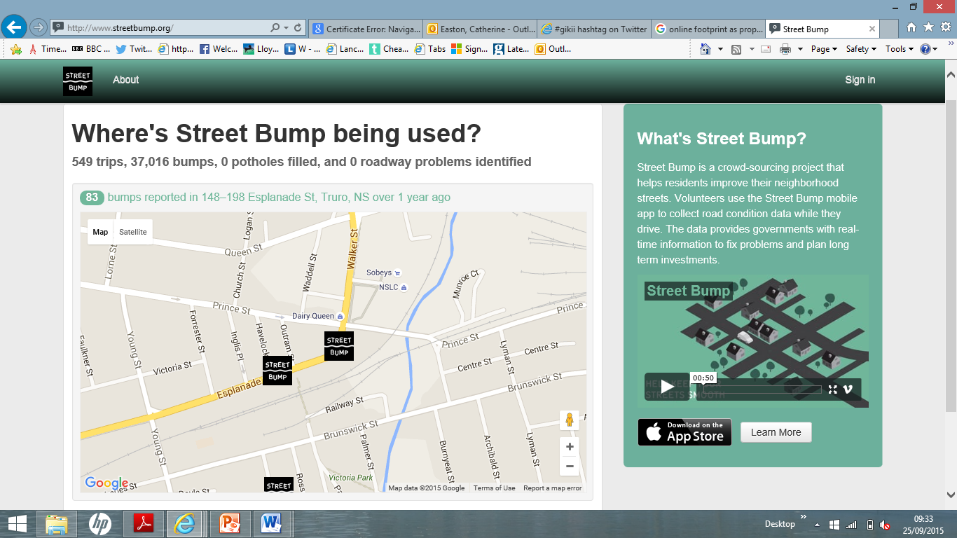

Slide 26
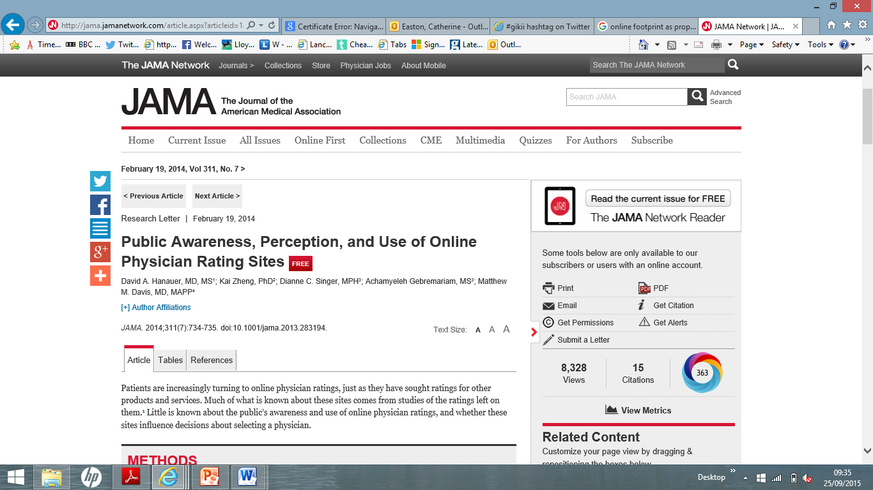

Slide 28
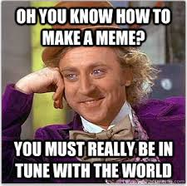
https://www.youtube.com/watch?v=SVi3-PrQ0pY

