Slide 1
I, Robot (2004)
Derek McAuley
Gikii 23rd Sept 2015

Slide 2
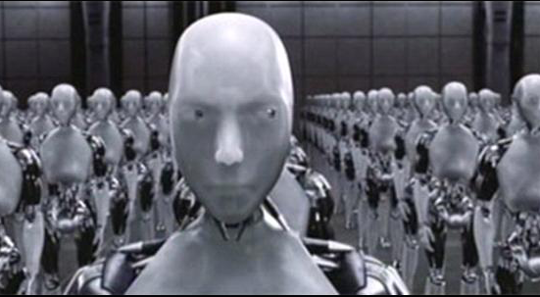
Sonny’s design parameters
Keep secrets;
Heterogeneity of processing;
Separation from central authority;
Denser alloy…

Slide 3
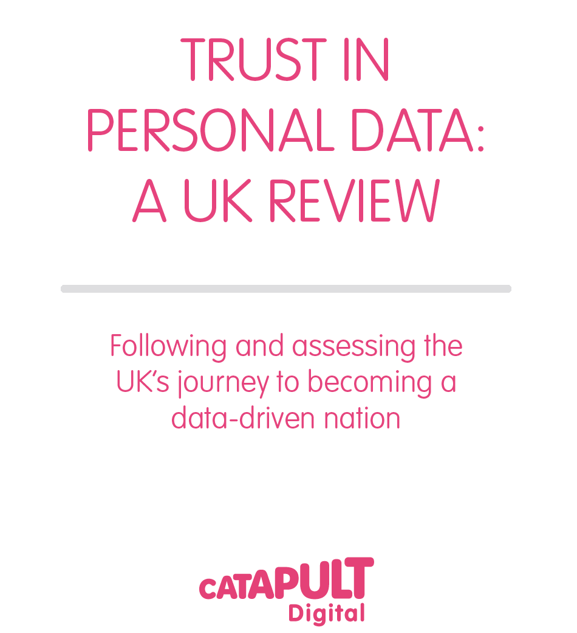
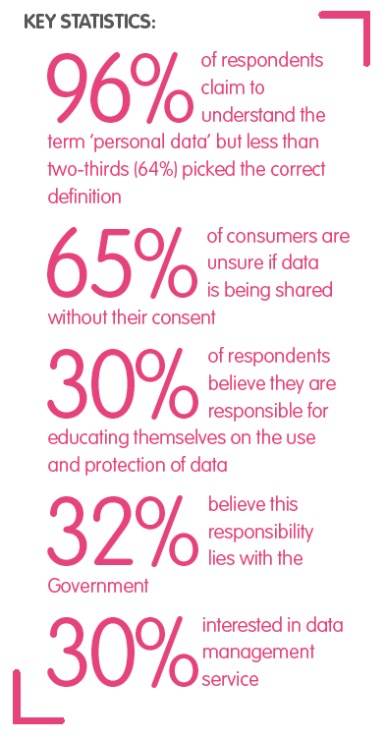

Slide 4
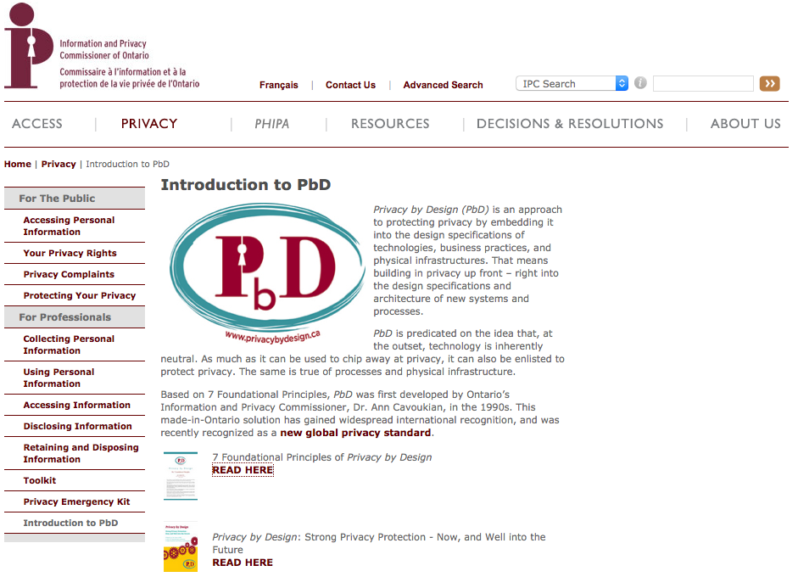
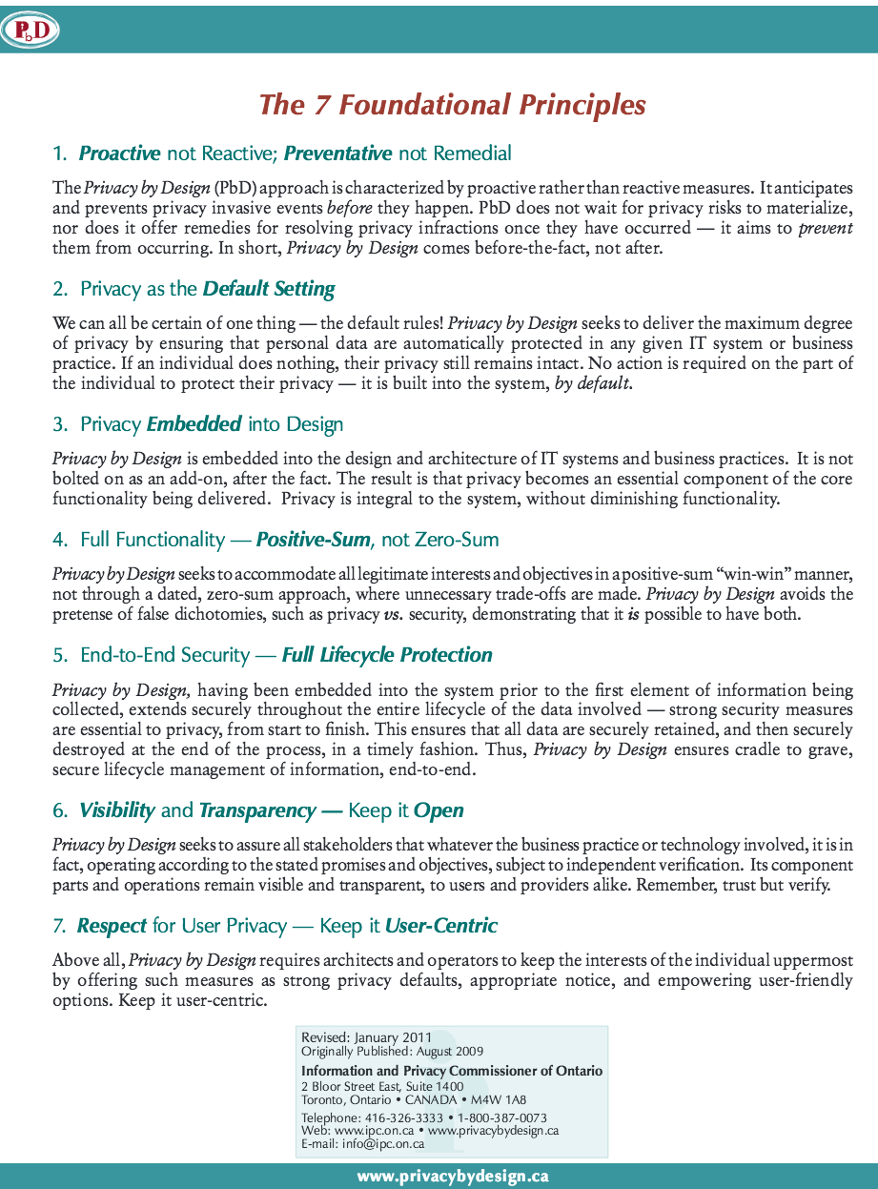
Privacy by Design?
Plumbane? Surely PbD₄

Slide 5
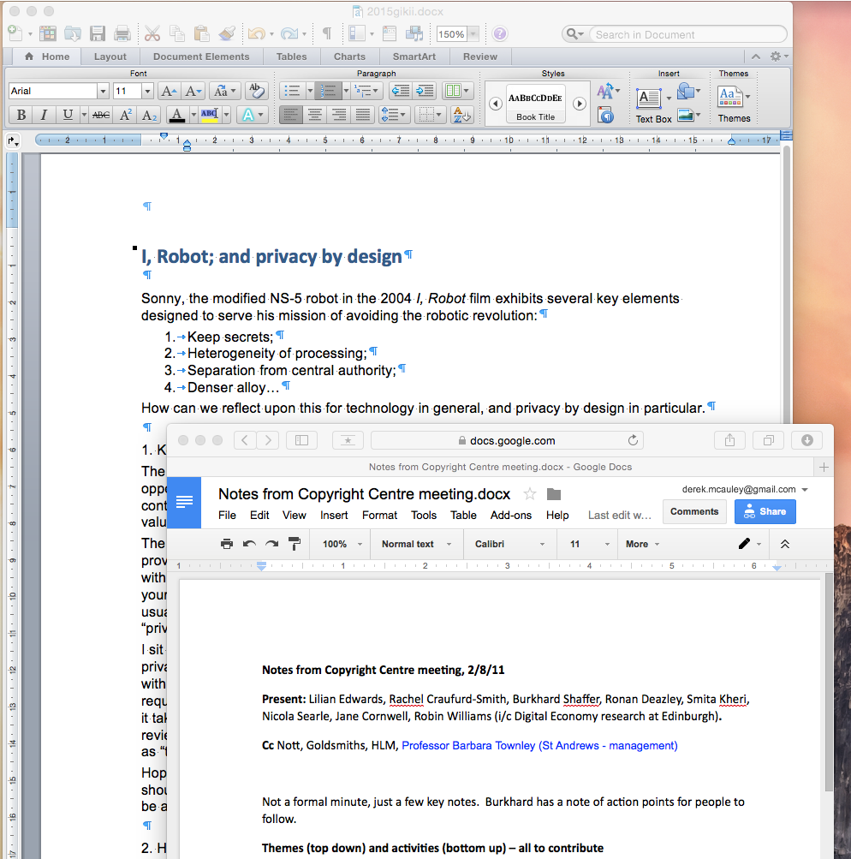
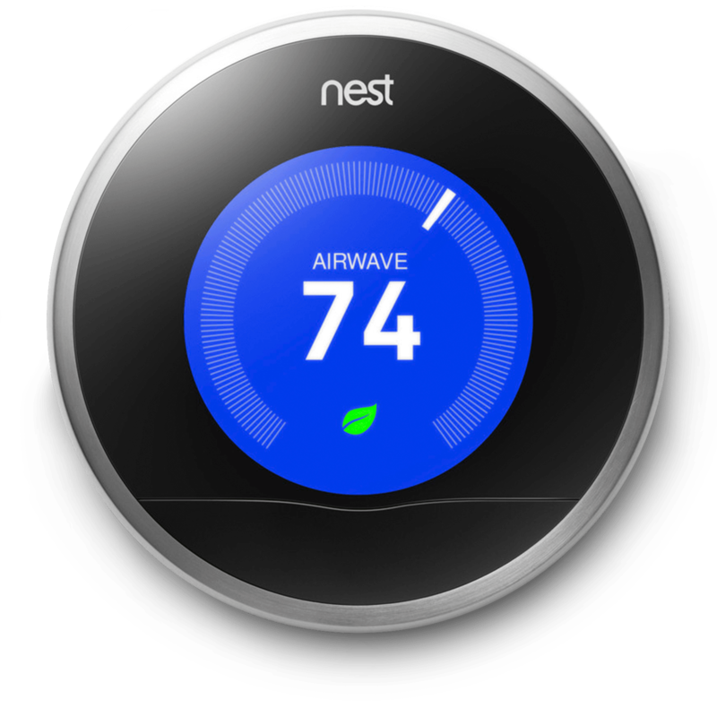
Why share?
Commercial
Multisided market
Technical
Lazy
Incompetent

Slide 6
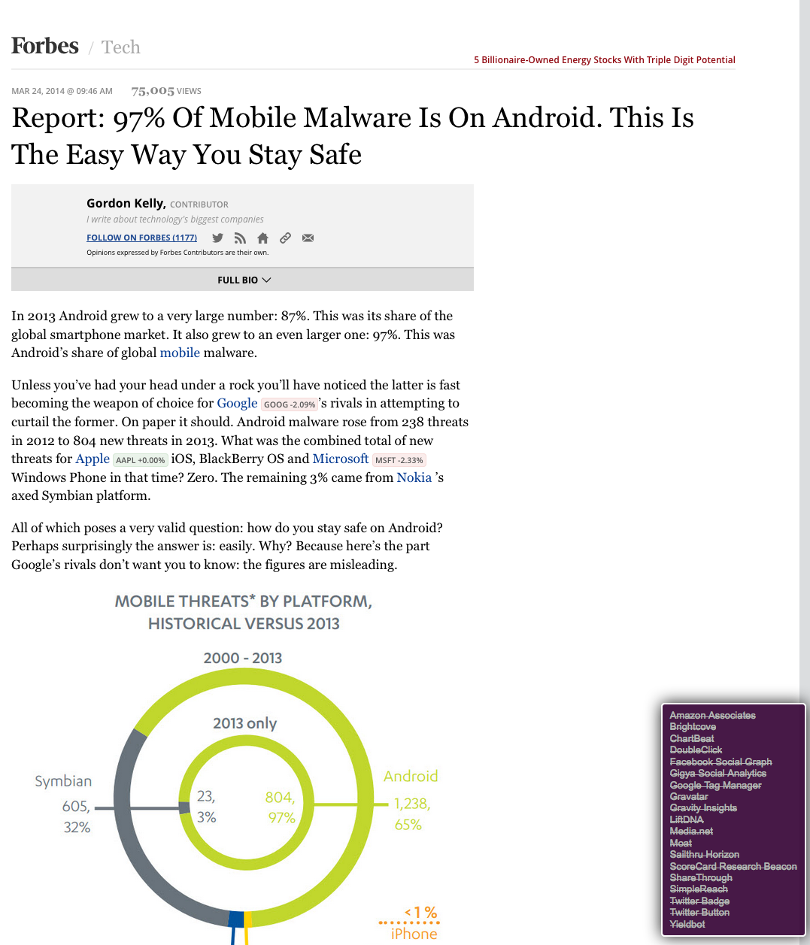
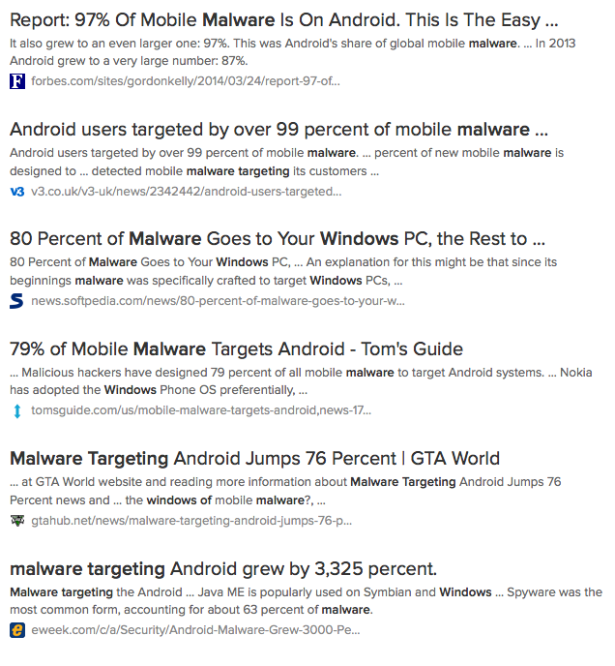
97% of malware is on Forbes

Slide 7
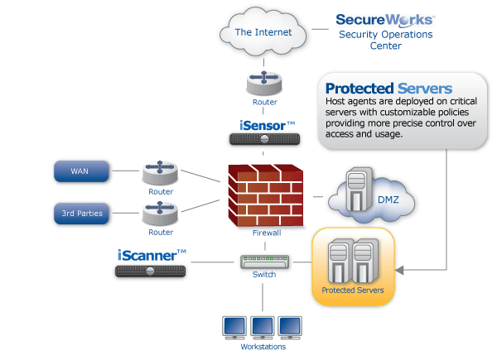
Quis custodiet ipsos custodes
Need external agents
Independently implemented

Slide 8
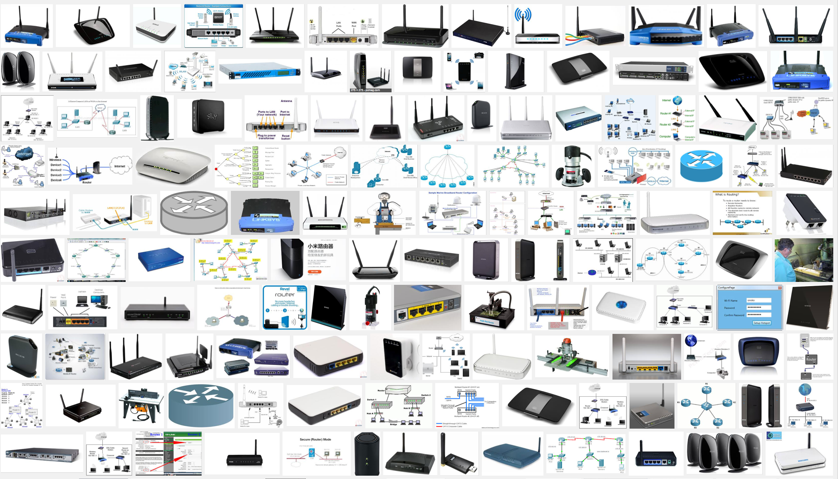
Humans in the loop

Slide 9
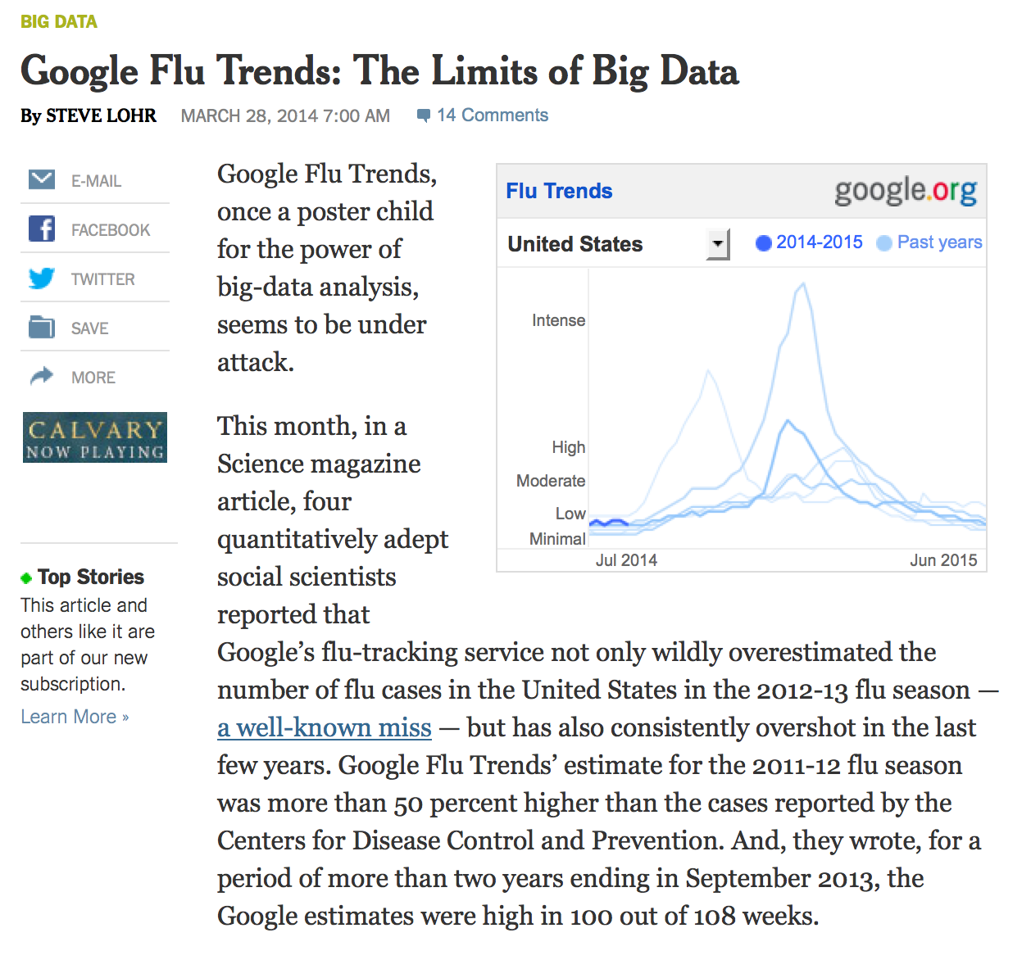
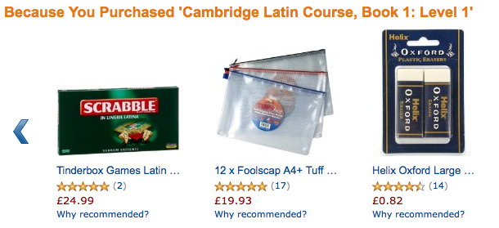
Humans are the loop

Slide 10
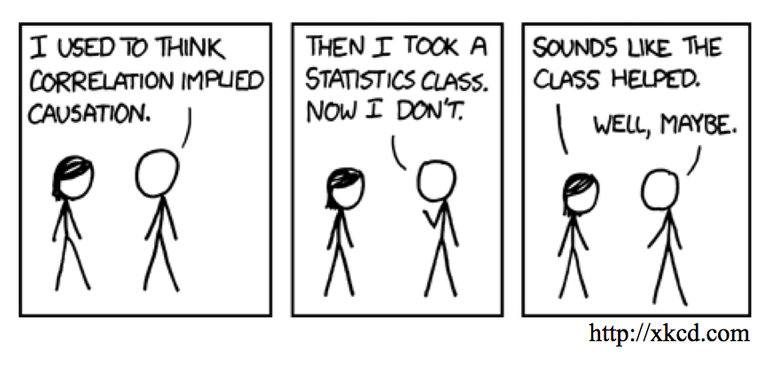
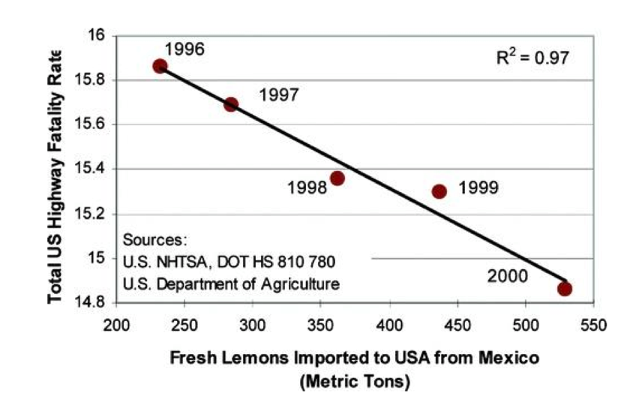
Danger in data

Slide 11
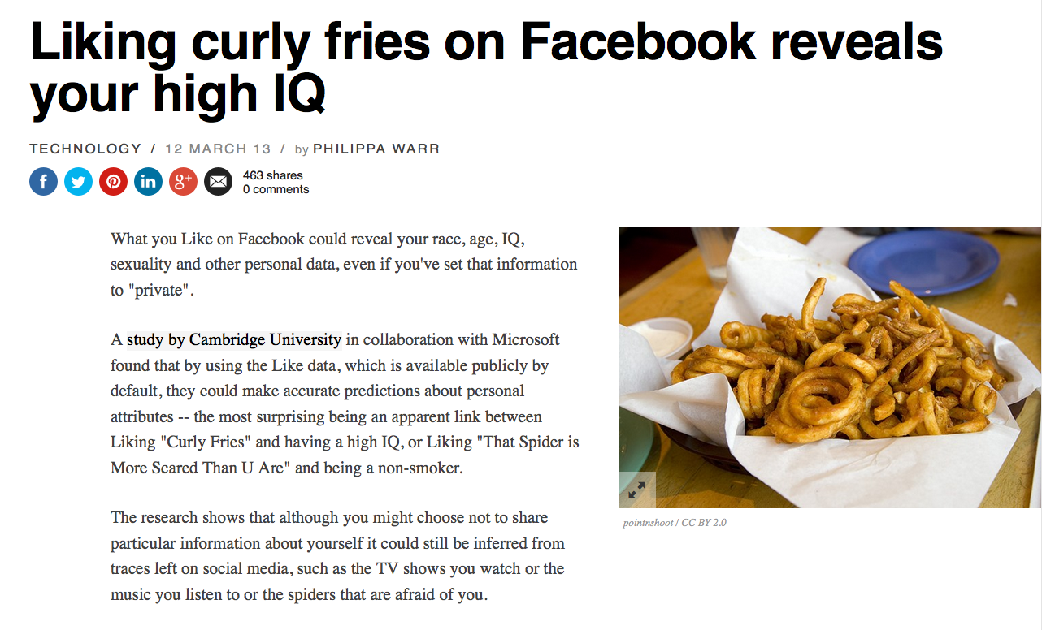
Homophily, social correlation…

Slide 12
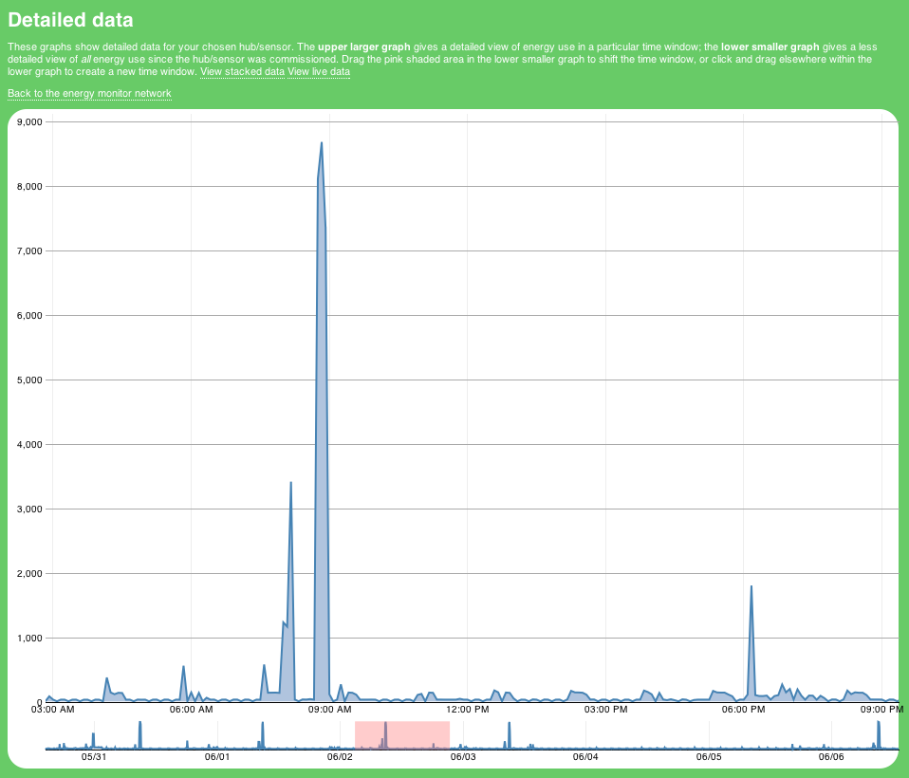
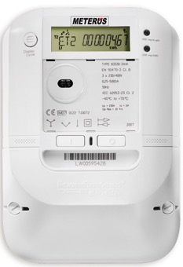
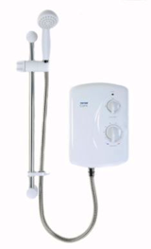
Privacy and smart meters
Rollout across UK by 2020
..but…
Readings once a day, or opt in to 30 mins or opt out to 1 month.

Slide 13
Data on the edge
Mainstream thinking: aggregate into cloud then analyze
Big
data
Statistics /
Decisions
Analyze
Cloud
Aggregate
Edge
Small &
personal
data
Small
Statistics
The way of small data: analyze at edge and then aggregate
Privacy & performance & scalability

Slide 14
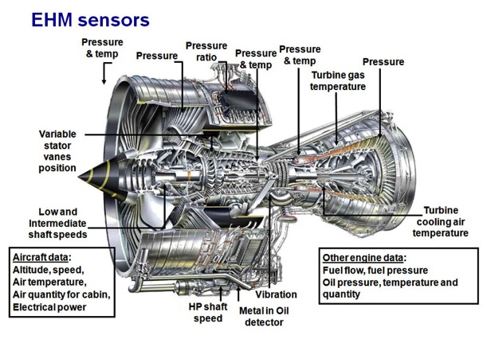
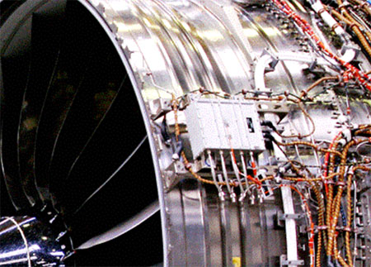
Engine monitoring
25 sensors per engine
high data capture rates
low bandwidth in flight
can’t backhaul all data
need distributed implementation
look for anomalies…
what needs to be real time?

Slide 15
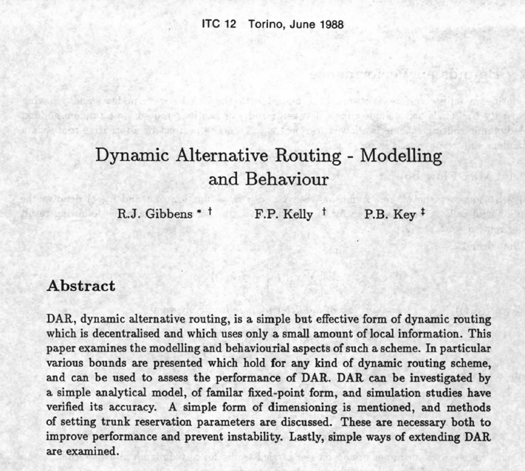
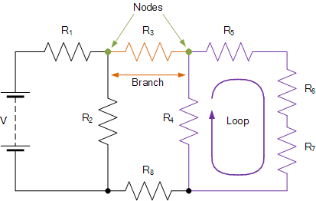
Examples…
Solve for voltages…
DAR [1]
[1] “Teletraffic Science”, ITC12. Elsevier, 1989.

Slide 16
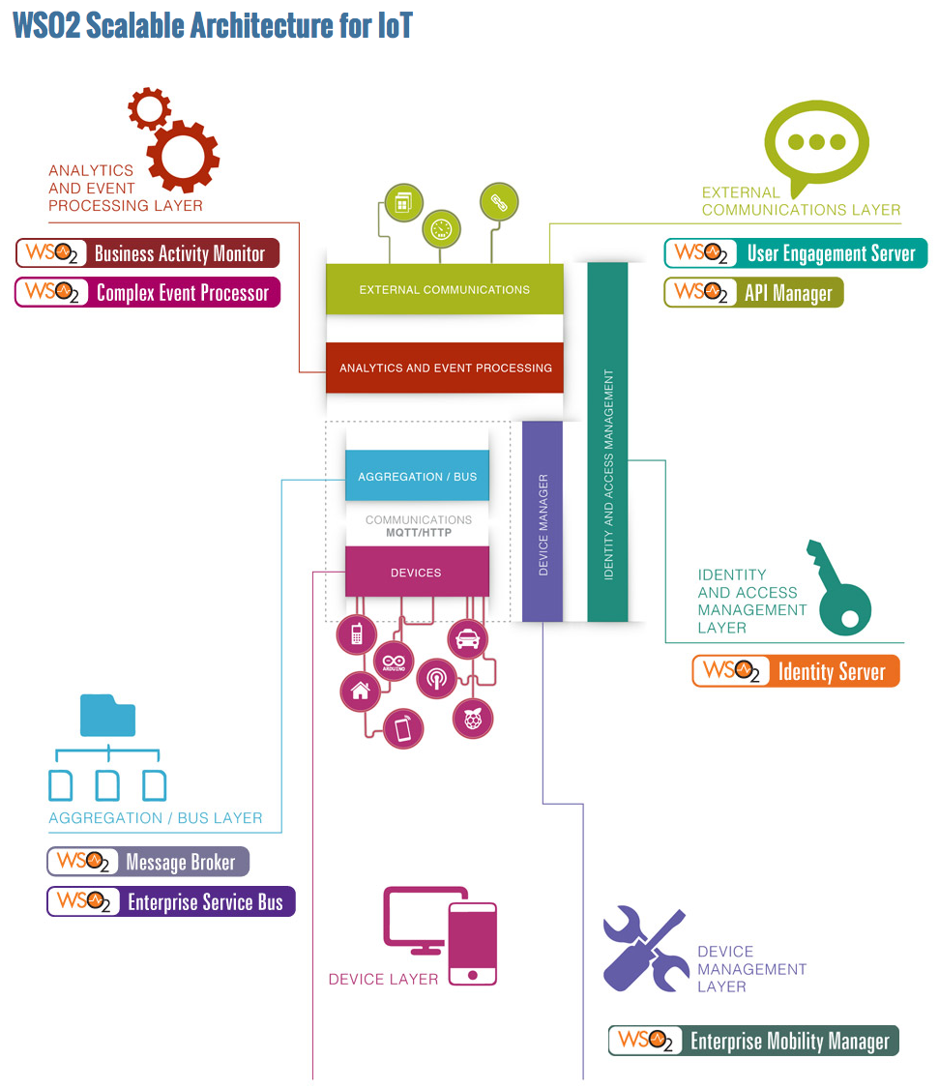
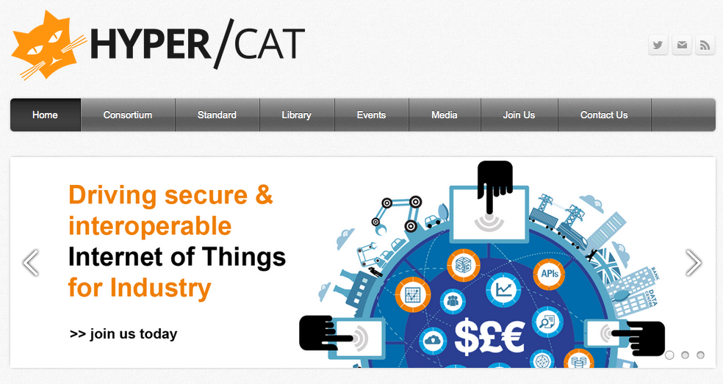
On the need for open

Slide 17
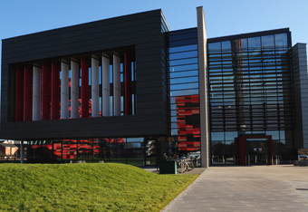
http://www.horizon.ac.uk
Questions?
derek.mcauley@nottingham.ac.uk

